Slide 1
Neurónové siete pre počítačové videnie šk.r. 2019-20
11 Visualizing and Understanding
Doc. RNDr. Milan Ftáčnik, CSc.
RNDr. Zuzana Černeková, PhD.

Slide 2
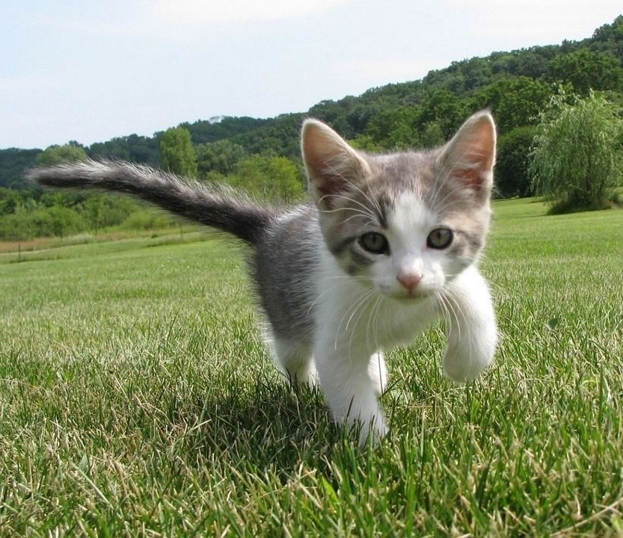
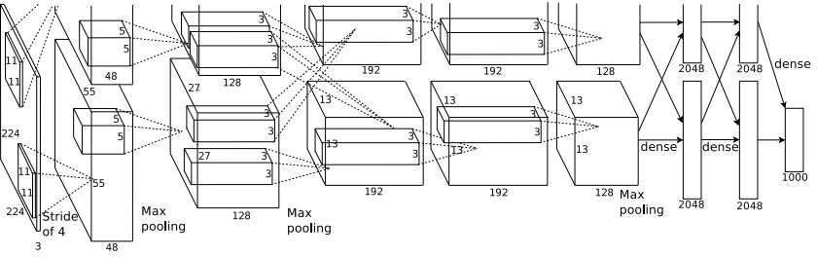
What’s going on inside ConvNets?
Class Scores: 1000 numbers
Input Image:
3 x 224 x 224
What are the intermediate features looking for?

Slide 3
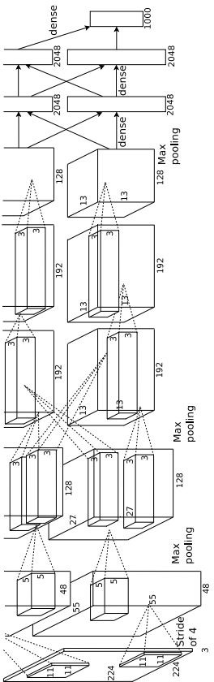
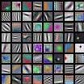



First Layer: Visualize Filters
ResNet-18: 64 x 3 x 7 x 7
ResNet-101: 64 x 3 x 7 x 7
DenseNet-121: 64 x 3 x 7 x 7
AlexNet:
64 x 3 x 11 x 11
Krizhevsky, “One weird trick for parallelizing convolutional neural networks”, arXiv 2014 He et al, “Deep Residual Learning for Image Recognition”, CVPR 2016
Huang et al, “Densely Connected Convolutional Networks”, CVPR 2017

Slide 4
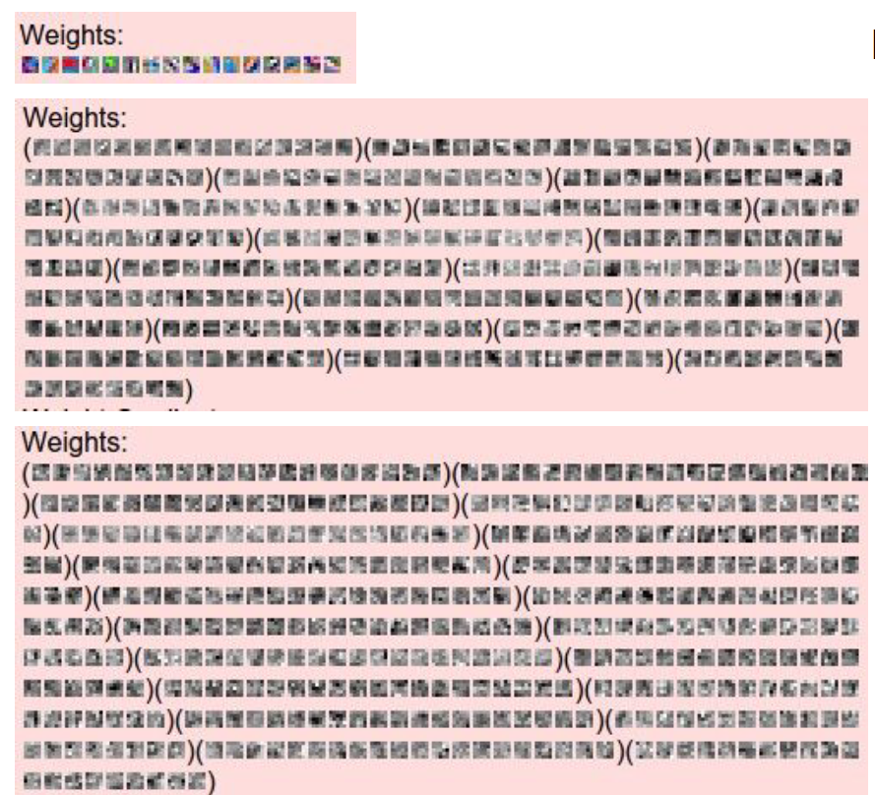
Visualize the filters/kernels (raw weights)
layer 1 weights
16 x 3 x 7 x 7
We can visualize filters at higher layers, but not that interesting
(these are taken from ConvNetJS CIFAR-10 demo)
layer 2 weights
20 x 16 x 7 x 7
layer 3 weights
20 x 20 x 7 x 7
Notes:
Weights are scaled to 0-255 to be able to visualise them

Slide 5
Last Layer
FC7 layer
4096-dimensional feature vector for an image (layer immediately before the classifier)
Run the network on many images, collect the feature vectors

Slide 6
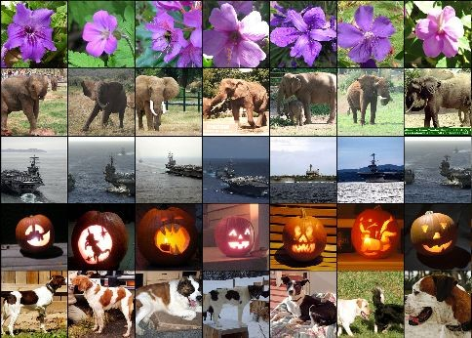
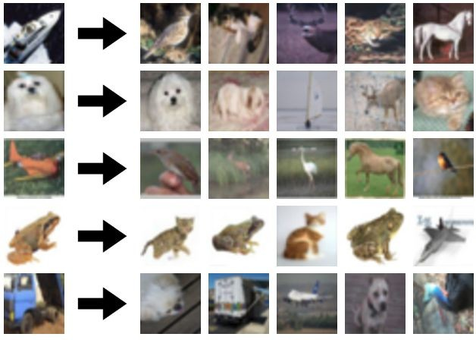
Last Layer: Nearest Neighbors
4096-dim vector
Test image
L2 Nearest neighbors in feature space
Recall: Nearest neighbors in pixel space

Slide 7
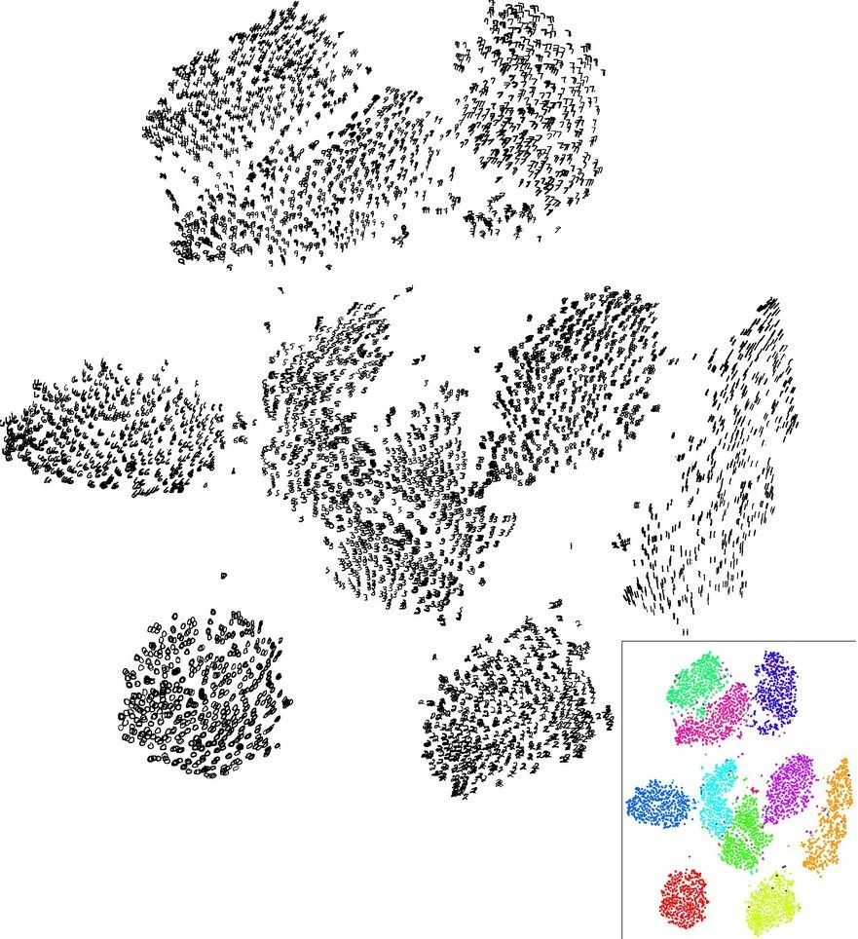
Last Layer: Dimensionality Reduction
Visualize the “space” of FC7 feature vectors by reducing dimensionality of vectors from 4096 to 2 dimensions
Simple algorithm: Principal Component Analysis (PCA)
More complex: t-SNE
Notes:
t-SNE non linear reduction method
Mnist dataset digits
Klastre zodpovedaju cisliciam

Slide 8
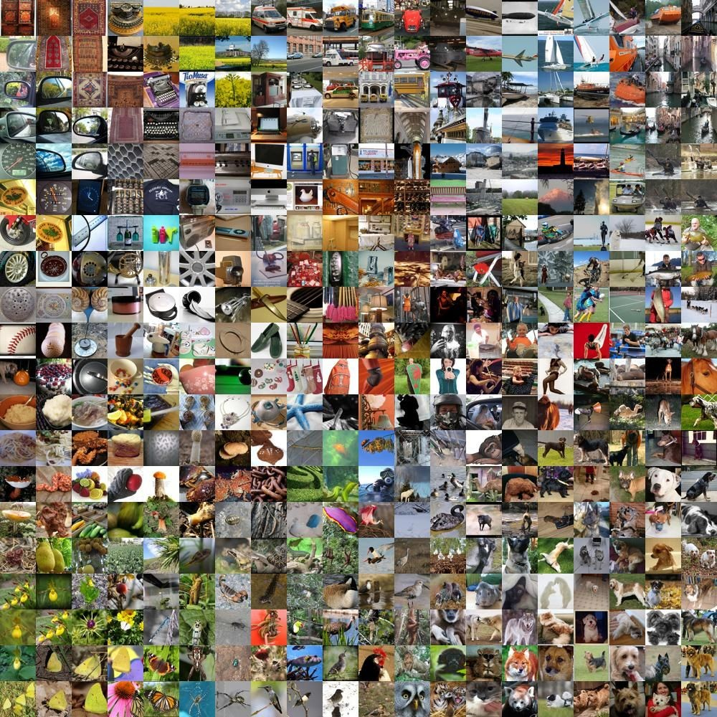
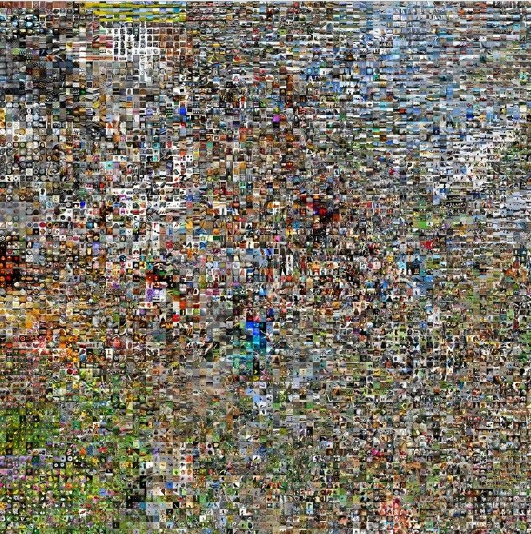
Last Layer: Dimensionality Reduction
Van der Maaten and Hinton, “Visualizing Data using t-SNE”, JMLR 2008
Krizhevsky et al, “ImageNet Classification with Deep Convolutional Neural Networks”, NIPS 2012.
See high-resolution versions at http://cs.stanford.edu/people/karpathy/cnnembed/
Notes:
Image Net classifier
Run many images through net , collect the 4096 dim features vector, run tSNE to reduce it to 2 dim , lay a grid and vizualize the images

Slide 9
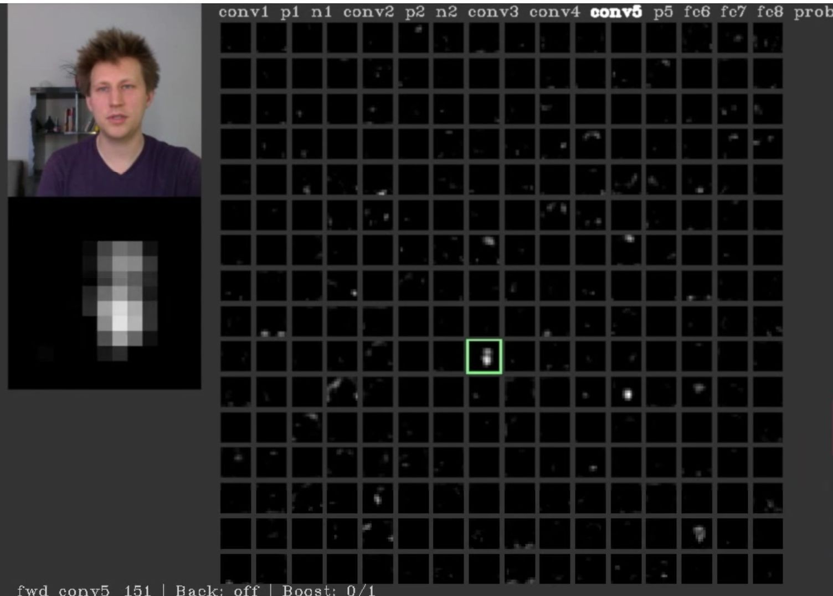
Visualizing Activations
AlexNet trained on ImageNet
conv5 feature map is 128x13x13; visualize as 128 13x13 grayscale images
Yosinski et al, “Understanding Neural Networks Through Deep Visualization”, ICML DL Workshop 2014.
Notes:
Zda sa ze jeden neuron sa aktivuje pri detekcii tvare / farby pokozky

Slide 10
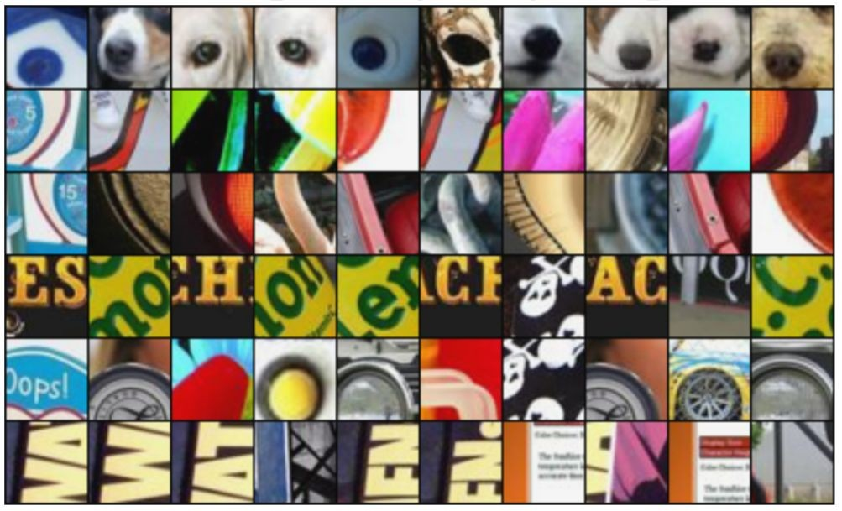
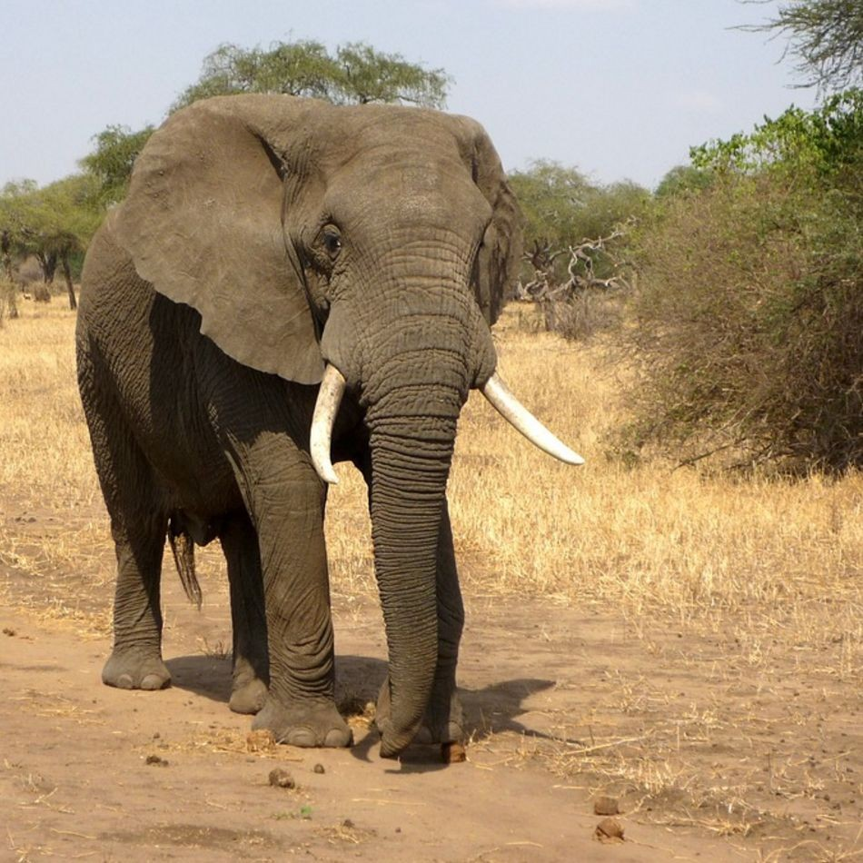
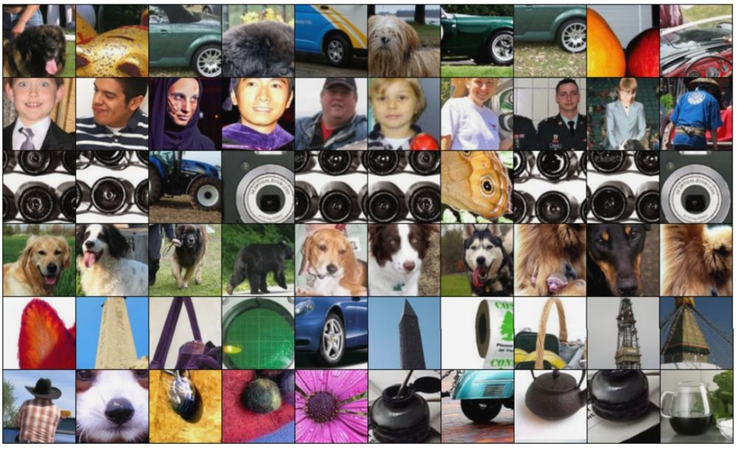
Maximally Activating Patches
Pick a layer and a channel; e.g. conv5 is 128 x 13 x 13, pick channel 17/128
Run many images through the network, record values of chosen channel
Visualize image patches that correspond to maximal activations
Springenberg et al, “Striving for Simplicity: The All Convolutional Net”, ICLR Workshop 2015
Figure copyright Jost Tobias Springenberg, Alexey Dosovitskiy, Thomas Brox, Martin Riedmiller, 2015;

Slide 11
Which pixels matter: Saliency via Occlusion
Mask part of the image before feeding to CNN, check how much predicted probabilities change
P(elephant) = 0.95
P(elephant) = 0.75
Zeiler and Fergus, “Visualizing and Understanding Convolutional Networks”, ECCV 2014
Notes:
Hladame ktore casti obrazu su dolezite pre rozhodovanie siete co je na obrazku

Slide 12
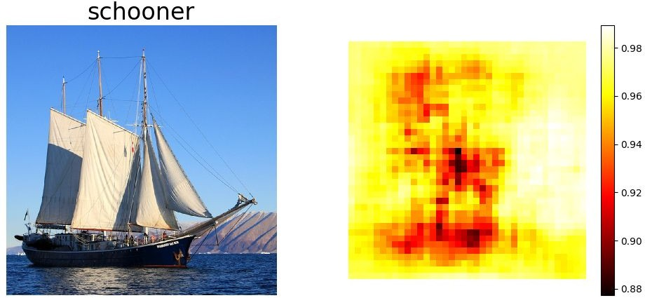
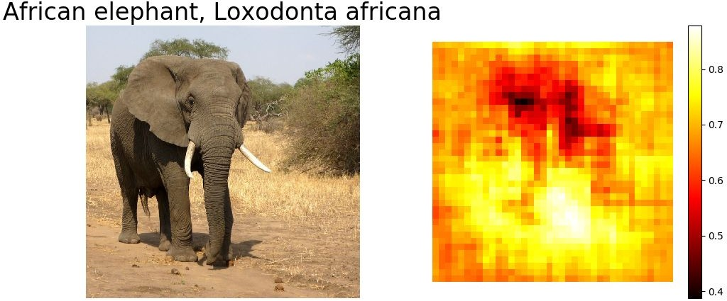
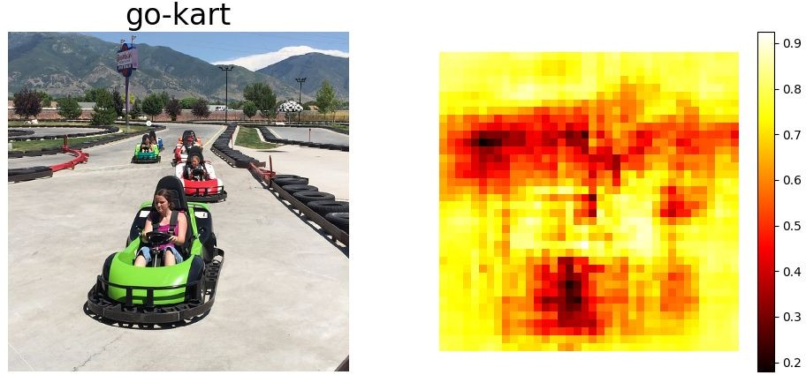
Which pixels matter: Saliency via Occlusion
Mask part of the image before feeding to CNN, check how much predicted probabilities change
Zeiler and Fergus, “Visualizing and Understanding Convolutional Networks”, ECCV 2014
Notes:
Postupne zakryvam casti obrazka a ukladam si pre danu cast pravdepodobnost s akou bol obrazok zatriedeny do spravnej kategorie.
Ked prekryjem cervene – cierne casti z heat mapy tak pravdepodobnost rapidne klesla tj su dolezite

Slide 13
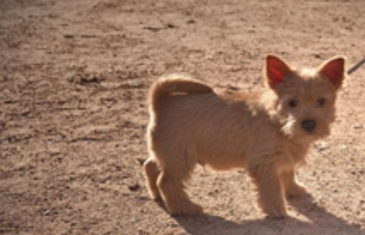
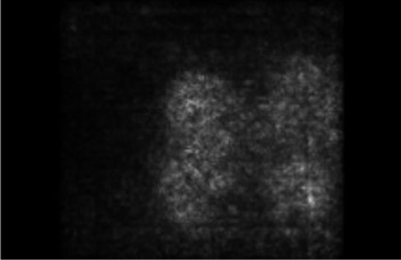
Which pixels matter: Saliency via Backprop
Forward pass: Compute probabilities
Dog
Compute gradient of (unnormalized) class score with respect to image pixels, take absolute value and max over RGB channels
Notes:
Pre kazdy pixel na obrazku nam povie ako velmi je dolezity pre rozhodovanie,
Tj. Ak ho trochu smenim ako velmi sa zmeni skore pri klasifikacii tohto obrazka

Slide 14
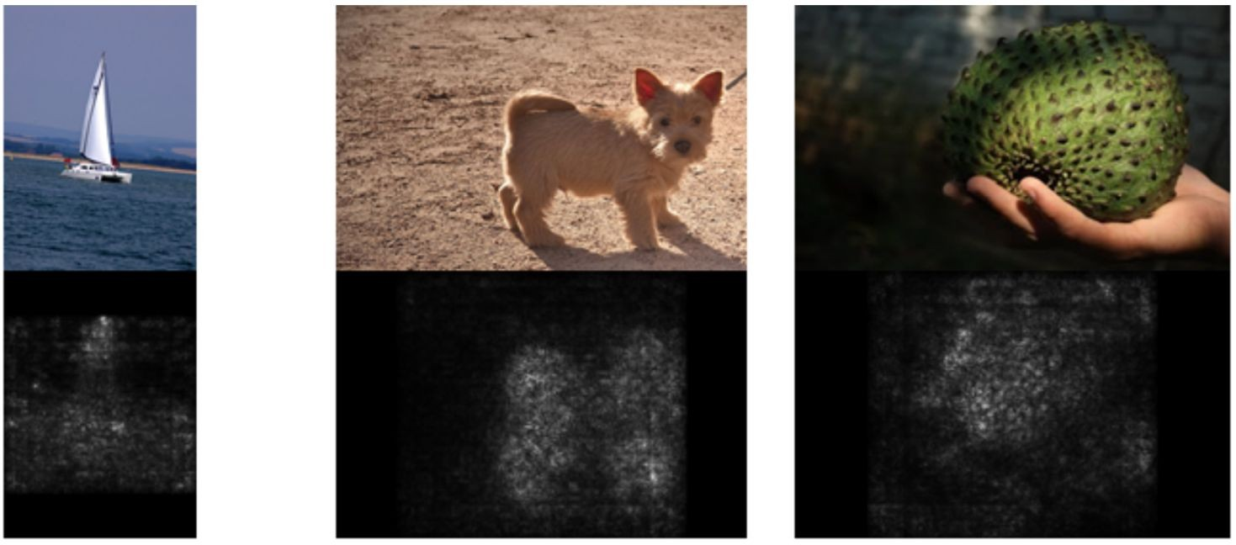
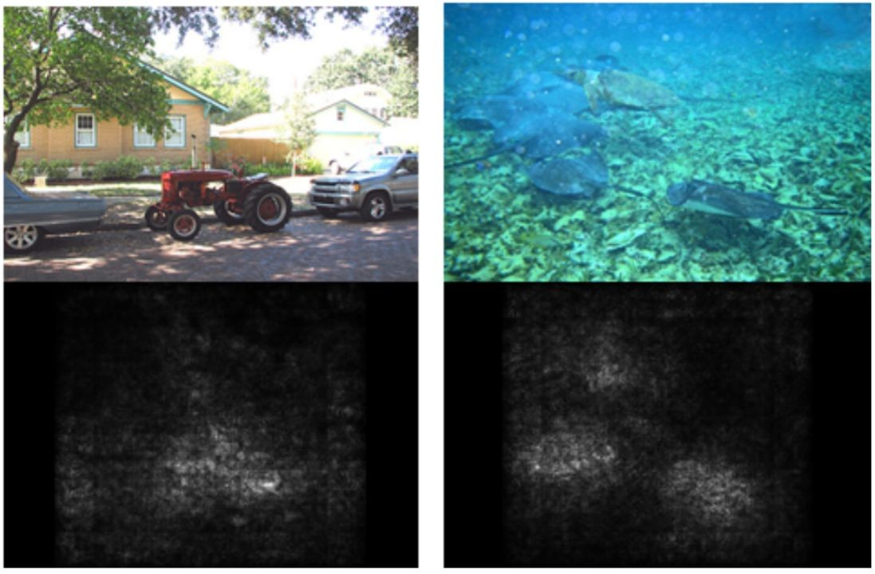
Saliency Maps

Slide 15
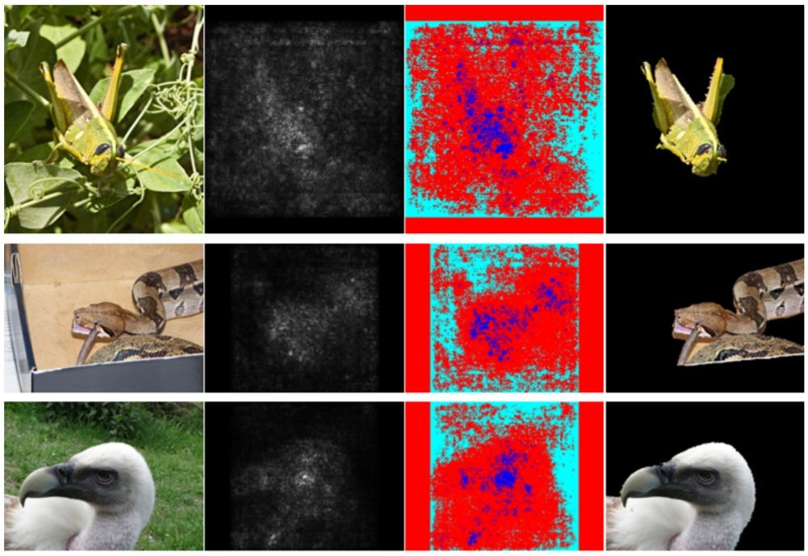
Saliency Maps: Segmentation without supervision
Use GrabCut on saliency map

Slide 16
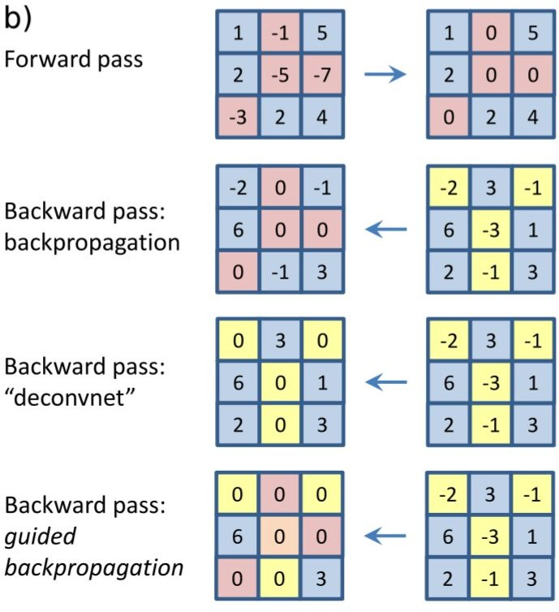
Intermediate Features via (guided) backprop
ReLU
Pick a single intermediate neuron, e.g. one value in 128 x 13 x 13 conv5 feature map
Compute gradient of neuron value with respect to image pixels
Images come out nicer if you only backprop positive gradients through each ReLU (guided backprop)
Zeiler and Fergus, “Visualizing and Understanding Convolutional Networks”, ECCV 2014
Springenberg et al, “Striving for Simplicity: The All Convolutional Net”, ICLR Workshop 2015

Slide 17
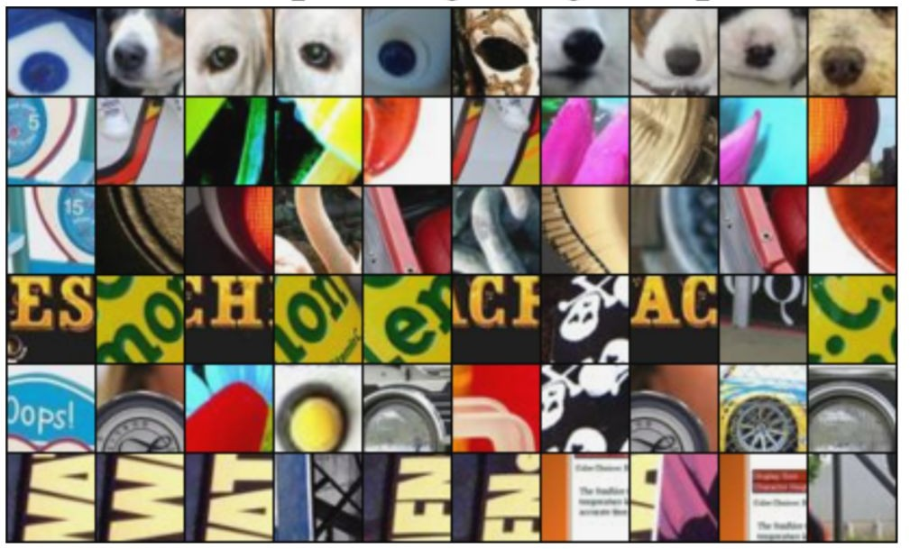
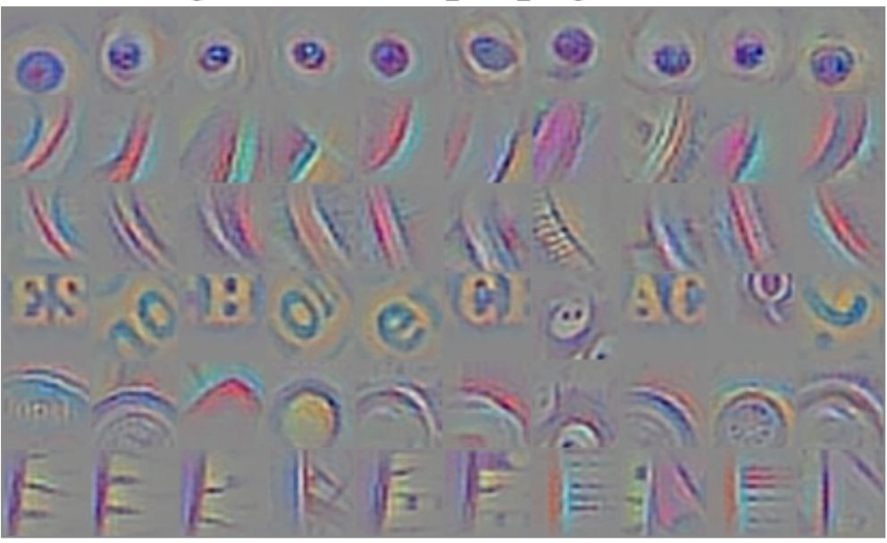
Intermediate features via (guided) backprop
Maximally activating patches (Each row is a different neuron)
Guided Backprop
Zeiler and Fergus, “Visualizing and Understanding Convolutional Networks”, ECCV 2014 Springenberg et al, “Striving for Simplicity: The All Convolutional Net”, ICLR Workshop 2015
Notes:
Guided backprop na povie presne ktore casti z tych patchov su dolezite

Slide 18
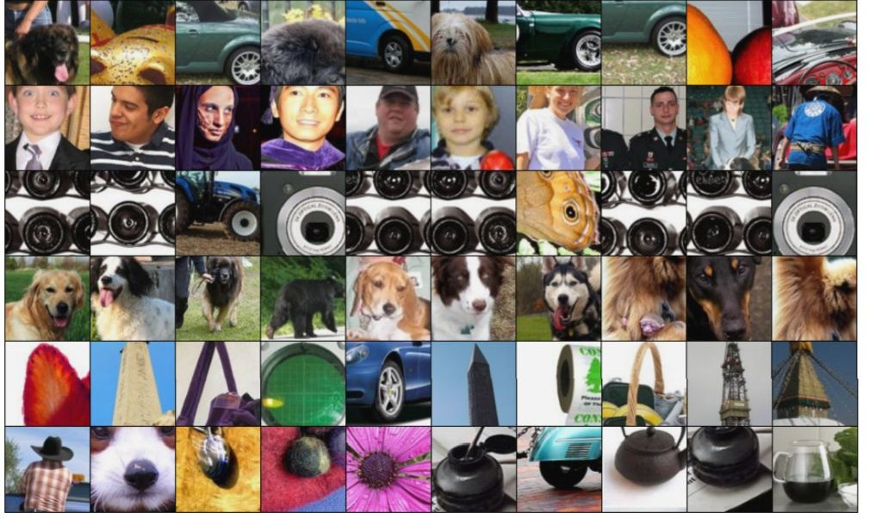
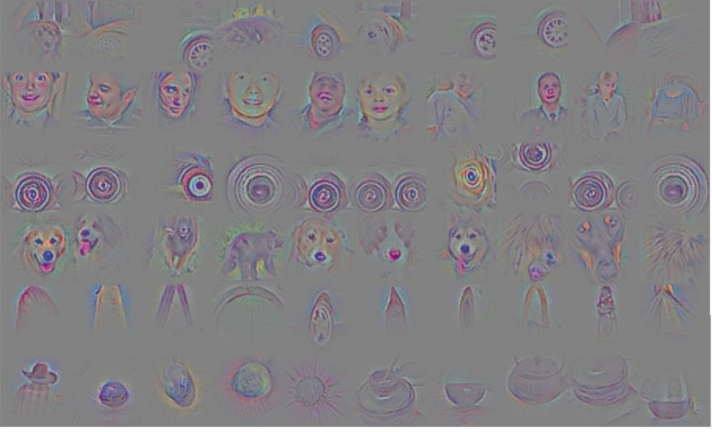
Intermediate features via (guided) backprop
Maximally activating patches (Each row is a different neuron)
Guided Backprop
Zeiler and Fergus, “Visualizing and Understanding Convolutional Networks”, ECCV 2014 Springenberg et al, “Striving for Simplicity: The All Convolutional Net”, ICLR Workshop 2015

Slide 19
Visualizing CNN features: Gradient Ascent
(Guided) backprop: Find the part of an image that a neuron responds to
Gradient ascent: Generate a synthetic image that maximally activates a neuron
I* = arg max_{I}
f(I)
+ R(I)
Neuron value
Natural image regularizer
Notes:
Doteraz sme sa pozerali ktora cast daneho vstupneho obrazka ma aky vplyv
Teraz sa pozrieme ktory obraz vseobecne najviac aktivuje dany neuron tj. Syntetizujeme obrazy
Gradient descent na minimalizovanie loss funkcie
Teraz zafixujeme vahy vo filtroch, urobime gradient ascent na pixloch obrazu aby sme maximalizovali skore nejakeho vnutorneho neuronu alebo triedy
Nemenime vahy ale hodnoty pixlov
Regularizer – aby sa nepreucil a aby sme dostali natural image, tj chceme statistiky ake sa nachadzaju pri normalnych obrazoch

Slide 20

Visualizing CNN features: Gradient Ascent
1. Initialize image to zeros
score for class c (before Softmax)
zero image
Repeat:
Forward image to compute current scores
Backprop to get gradient of neuron value with respect to image pixels
Make a small update to the image
Notes:
Vypocitam skore pre class alebo pre nejaky neuron ktory nas zaujima

Slide 21
Visualizing CNN features: Gradient Ascent
Simple regularizer: Penalize L2 norm of generated image
Simonyan, Vedaldi, and Zisserman, “Deep Inside Convolutional Networks: Visualising Image Classification Models and Saliency Maps”, ICLR Workshop 2014.

Slide 22
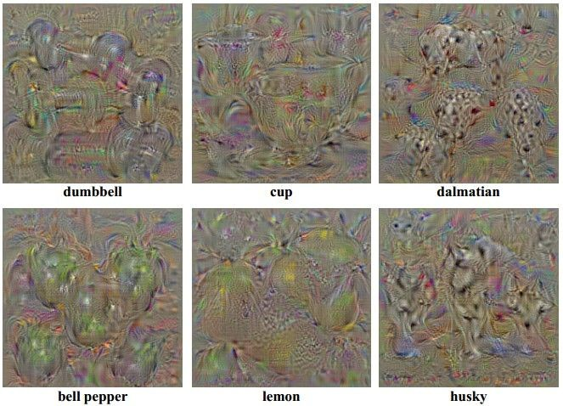
Visualizing CNN features: Gradient Ascent
Simple regularizer: Penalize L2 norm of generated image
Simonyan, Vedaldi, and Zisserman, “Deep Inside Convolutional Networks: Visualising Image Classification Models and Saliency Maps”, ICLR Workshop 2014.
Notes:
Ak nepouzijem regularizer obraz sice maximalizuje skore vybraneho neuronu ale nevyzera ako obraz skor ako nejaky sum

Slide 23
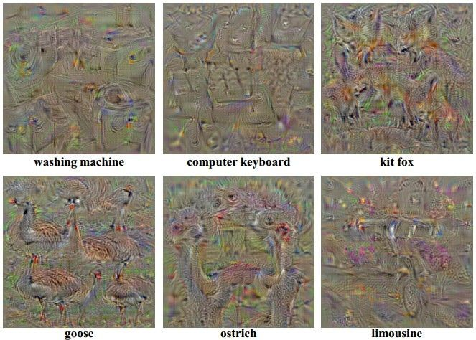
Visualizing CNN features: Gradient Ascent
Simple regularizer: Penalize L2 norm of generated image
Yosinski et al, “Understanding Neural Networks Through Deep Visualization”, ICML DL Workshop 2014.

Slide 24
Visualizing CNN features: Gradient Ascent
Better regularizer: Penalize L2 norm of image; also during optimization periodically
Gaussian blur image
Clip pixels with small values to 0
Clip pixels with small gradients to 0
Notes:
Gaussian blur napriklad aby bol hladky prechod medzi pixlami

Slide 25
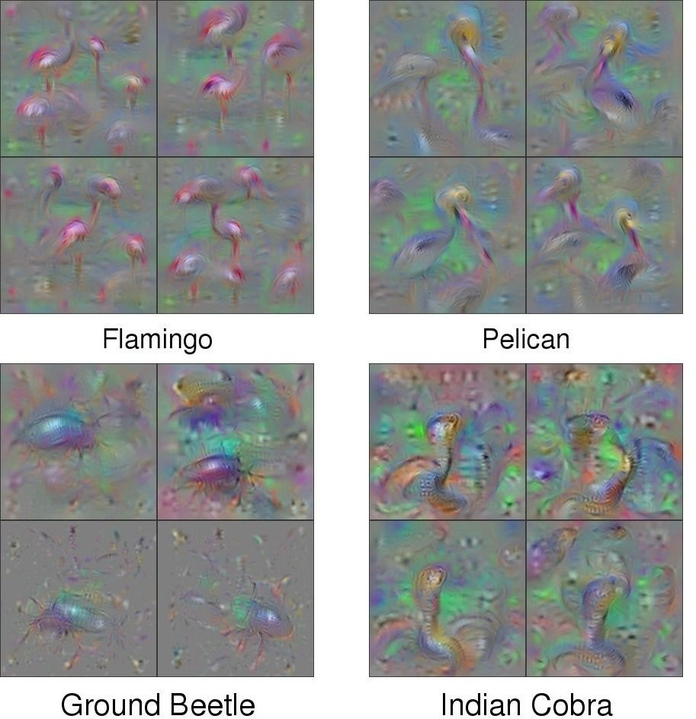
Visualizing CNN features: Gradient Ascent
Better regularizer: Penalize L2 norm of image; also during optimization periodically
Gaussian blur image
Clip pixels with small values to 0
Clip pixels with small gradients to 0
Notes:
4 obrazky pre kazde – 4 rozne random inicializacie

Slide 26
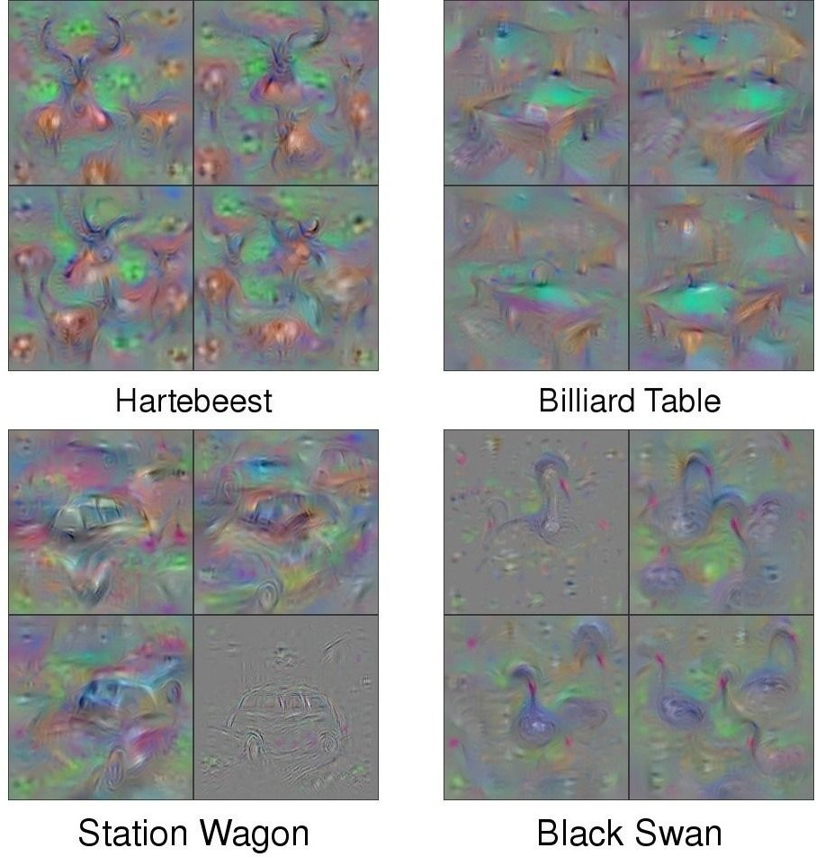
Visualizing CNN features: Gradient Ascent
Better regularizer: Penalize L2 norm of image; also during optimization periodically
Gaussian blur image
Clip pixels with small values to 0
Clip pixels with small gradients to 0

Slide 27
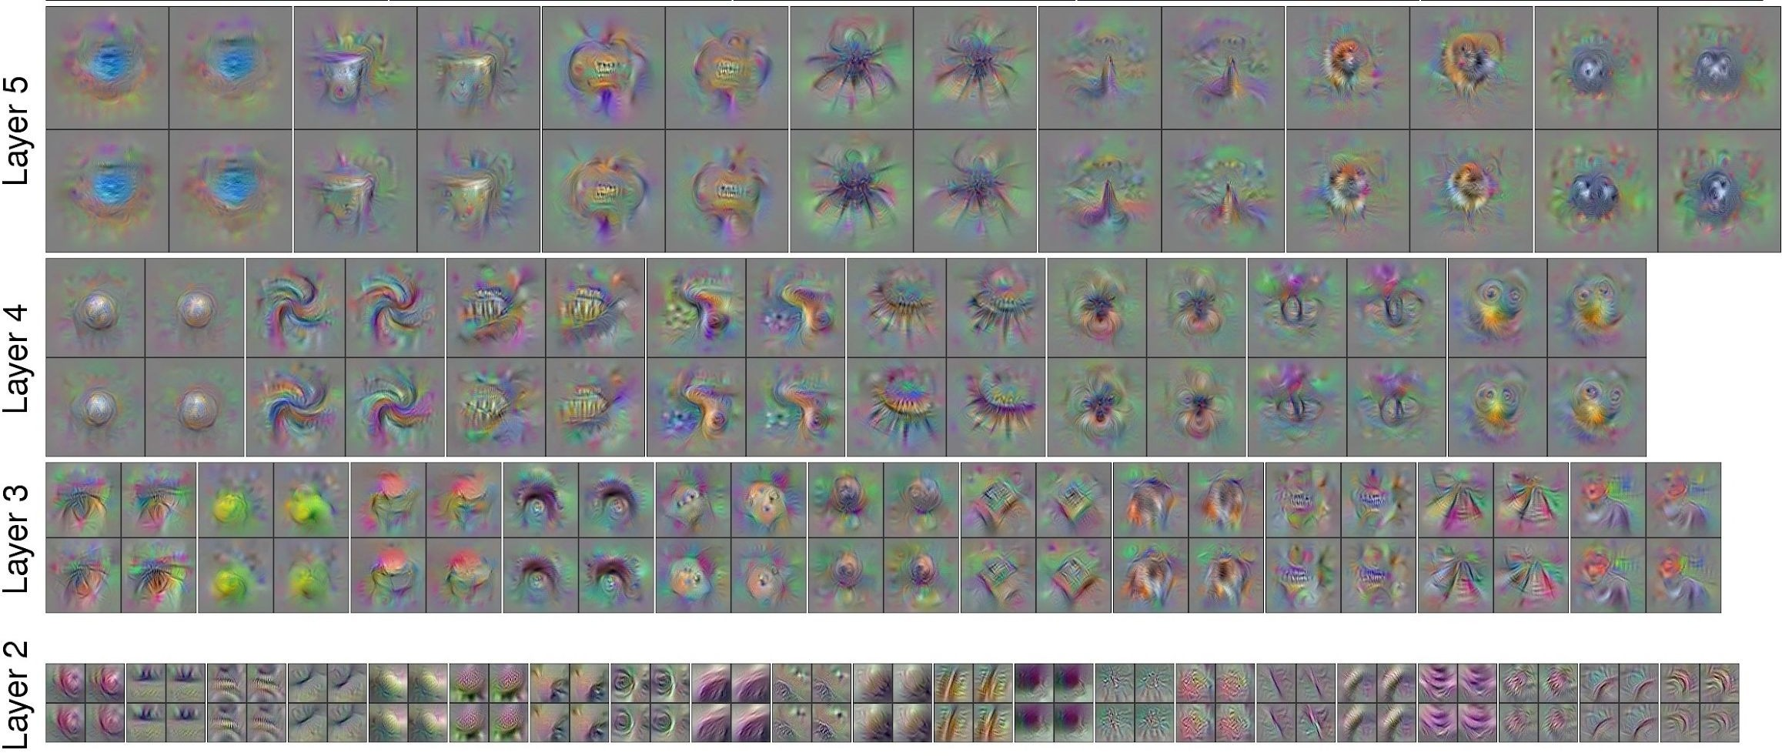
Visualizing CNN features: Gradient Ascent
Use the same approach to visualize intermediate features
Yosinski et al, “Understanding Neural Networks Through Deep Visualization”, ICML DL Workshop 2014.
Notes:
Co ktore neurony hladaju v obrazoch

Slide 28
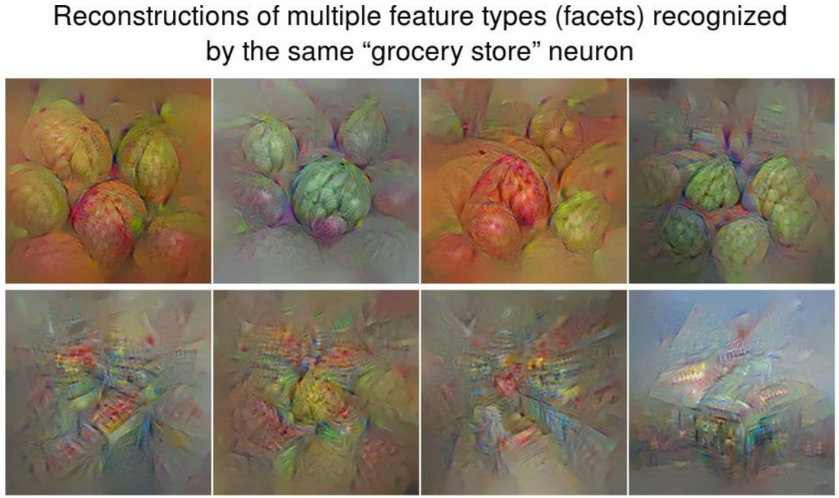
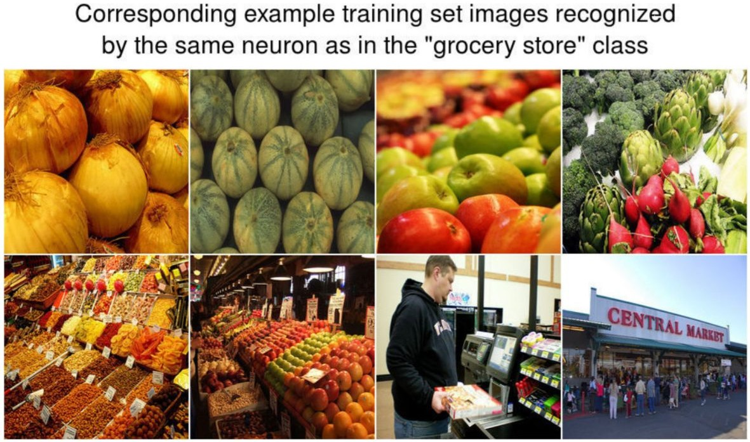
Visualizing CNN features: Gradient Ascent
Adding “multi-faceted” visualization gives even nicer results: (Plus more careful regularization, center-bias)
Nguyen et al, “Multifaceted Feature Visualization: Uncovering the Different Types of Features Learned By Each Neuron in Deep Neural Networks”, ICML Visualization for Deep Learning Workshop 2016.
Notes:
Multimodalita
Prvy riadok close up zaber ovocia / zeleniny , klasifikovany ako obchod s potravinami
2. Riadok obchod z vonku ludia prechadzajuci okolo, a stale klasifikovane ako grocery store

Slide 29
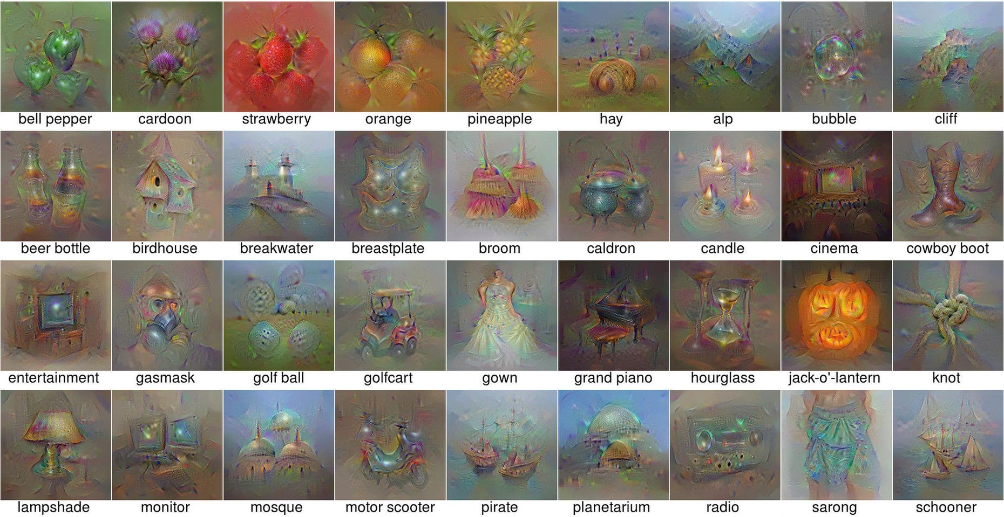
Visualizing CNN features: Gradient Ascent
Nguyen et al, “Multifaceted Feature Visualization: Uncovering the Different Types of Features Learned By Each Neuron in Deep Neural Networks”, ICML Visualization for Deep Learning Workshop 2016.
Notes:
Images of classes

Slide 30
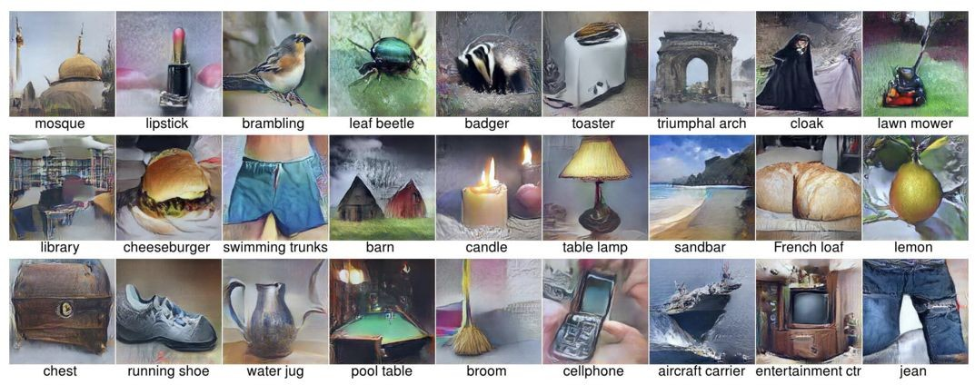
Visualizing CNN features: Gradient Ascent
Optimize in FC6 latent space instead of pixel space:
Nguyen et al, “Synthesizing the preferred inputs for neurons in neural networks via deep generator networks,” NIPS 2016

Slide 31
Fooling Images / Adversarial Examples
Start from an arbitrary image
Pick an arbitrary class
Modify the image to maximize the class
Repeat until network is fooled

Slide 32
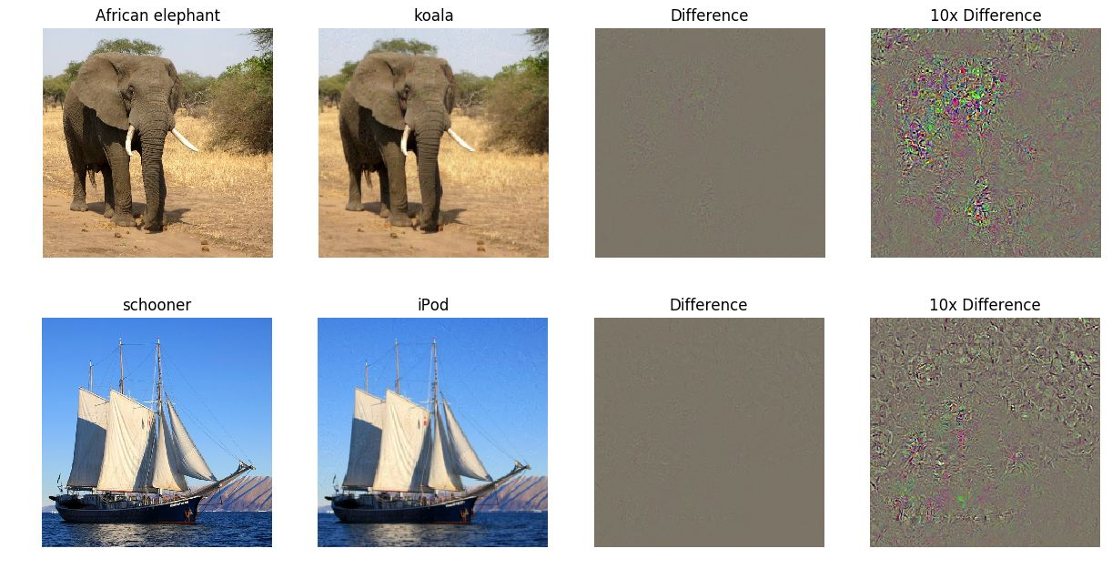
Fooling Images / Adversarial Examples
Check out Ian Goodfellow’s lecture from 2017

Slide 33
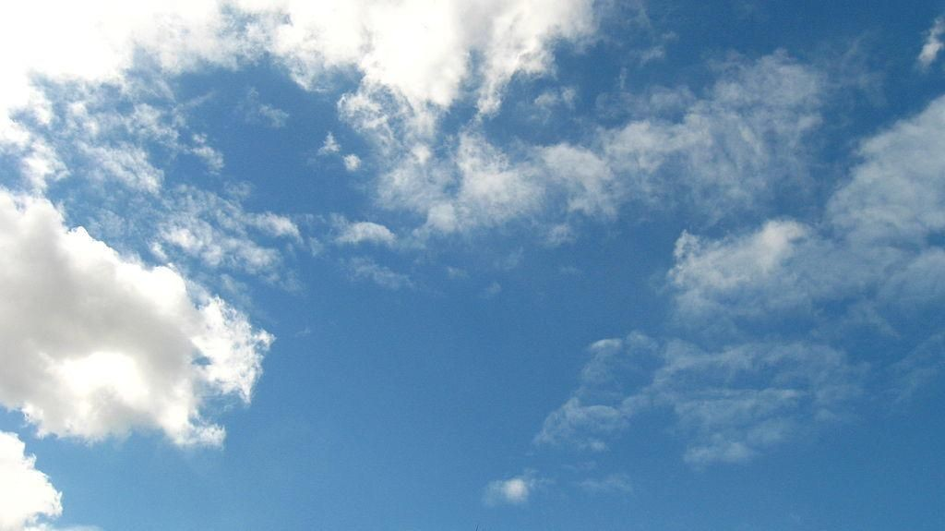
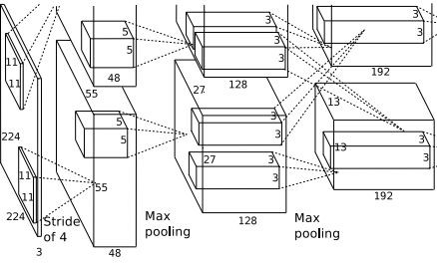
DeepDream: Amplify existing features
Rather than synthesizing an image to maximize a specific neuron, instead try to amplify the neuron activations at some layer in the network
Choose an image and a layer in a CNN; repeat:
Forward: compute activations at chosen layer
Set gradient of chosen layer equal to its activation
3.
4.
Backward: Compute gradient on image
Update image
Mordvintsev, Olah, and Tyka, “Inceptionism: Going Deeper into Neural Networks”, Google Research Blog.
Notes:
Amplify – zosilnit features ktore nasiel NN v obraze

Slide 34
DeepDream: Amplify existing features
Rather than synthesizing an image to maximize a specific neuron, instead try to amplify the neuron activations at some layer in the network
Choose an image and a layer in a CNN; repeat:
Forward: compute activations at chosen layer
Set gradient of chosen layer equal to its activation
Equivalent to:
I* = arg max_{I} ∑_{i} f_{i}(I)²
3.
4.
Backward: Compute gradient on image
Update image
Notes:
Snazi sa maximalizovat L2 normu danych features v danom layer

Slide 35
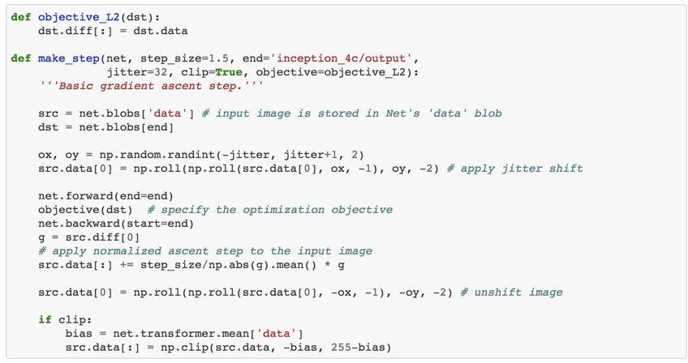
DeepDream: Amplify existing features
Code is very simple but it uses a couple tricks:

Slide 36
DeepDream: Amplify existing features
Code is very simple but it uses a couple tricks:
Jitter image

Slide 37
DeepDream: Amplify existing features
Code is very simple but it uses a couple tricks:
Jitter image
L1 Normalize gradients

Slide 38
DeepDream: Amplify existing features
Code is very simple but it uses a couple tricks:
Jitter image
L1 Normalize gradients
Clip pixel values

Slide 39
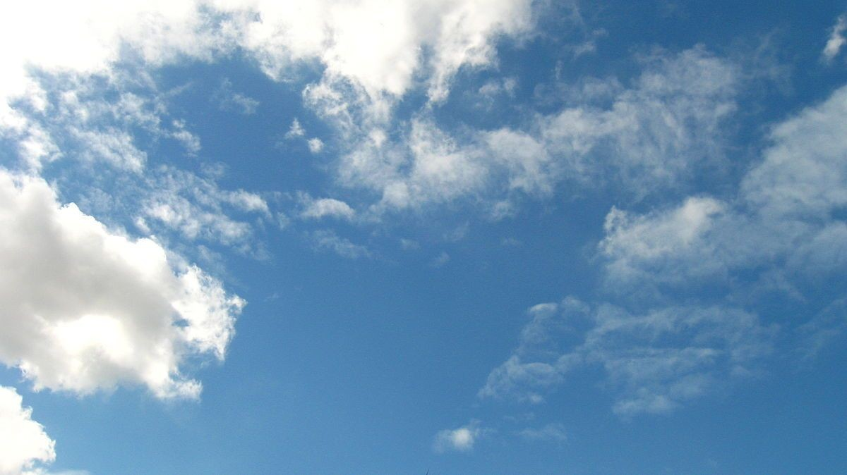

Slide 40

Notes:
Low level features

Slide 41
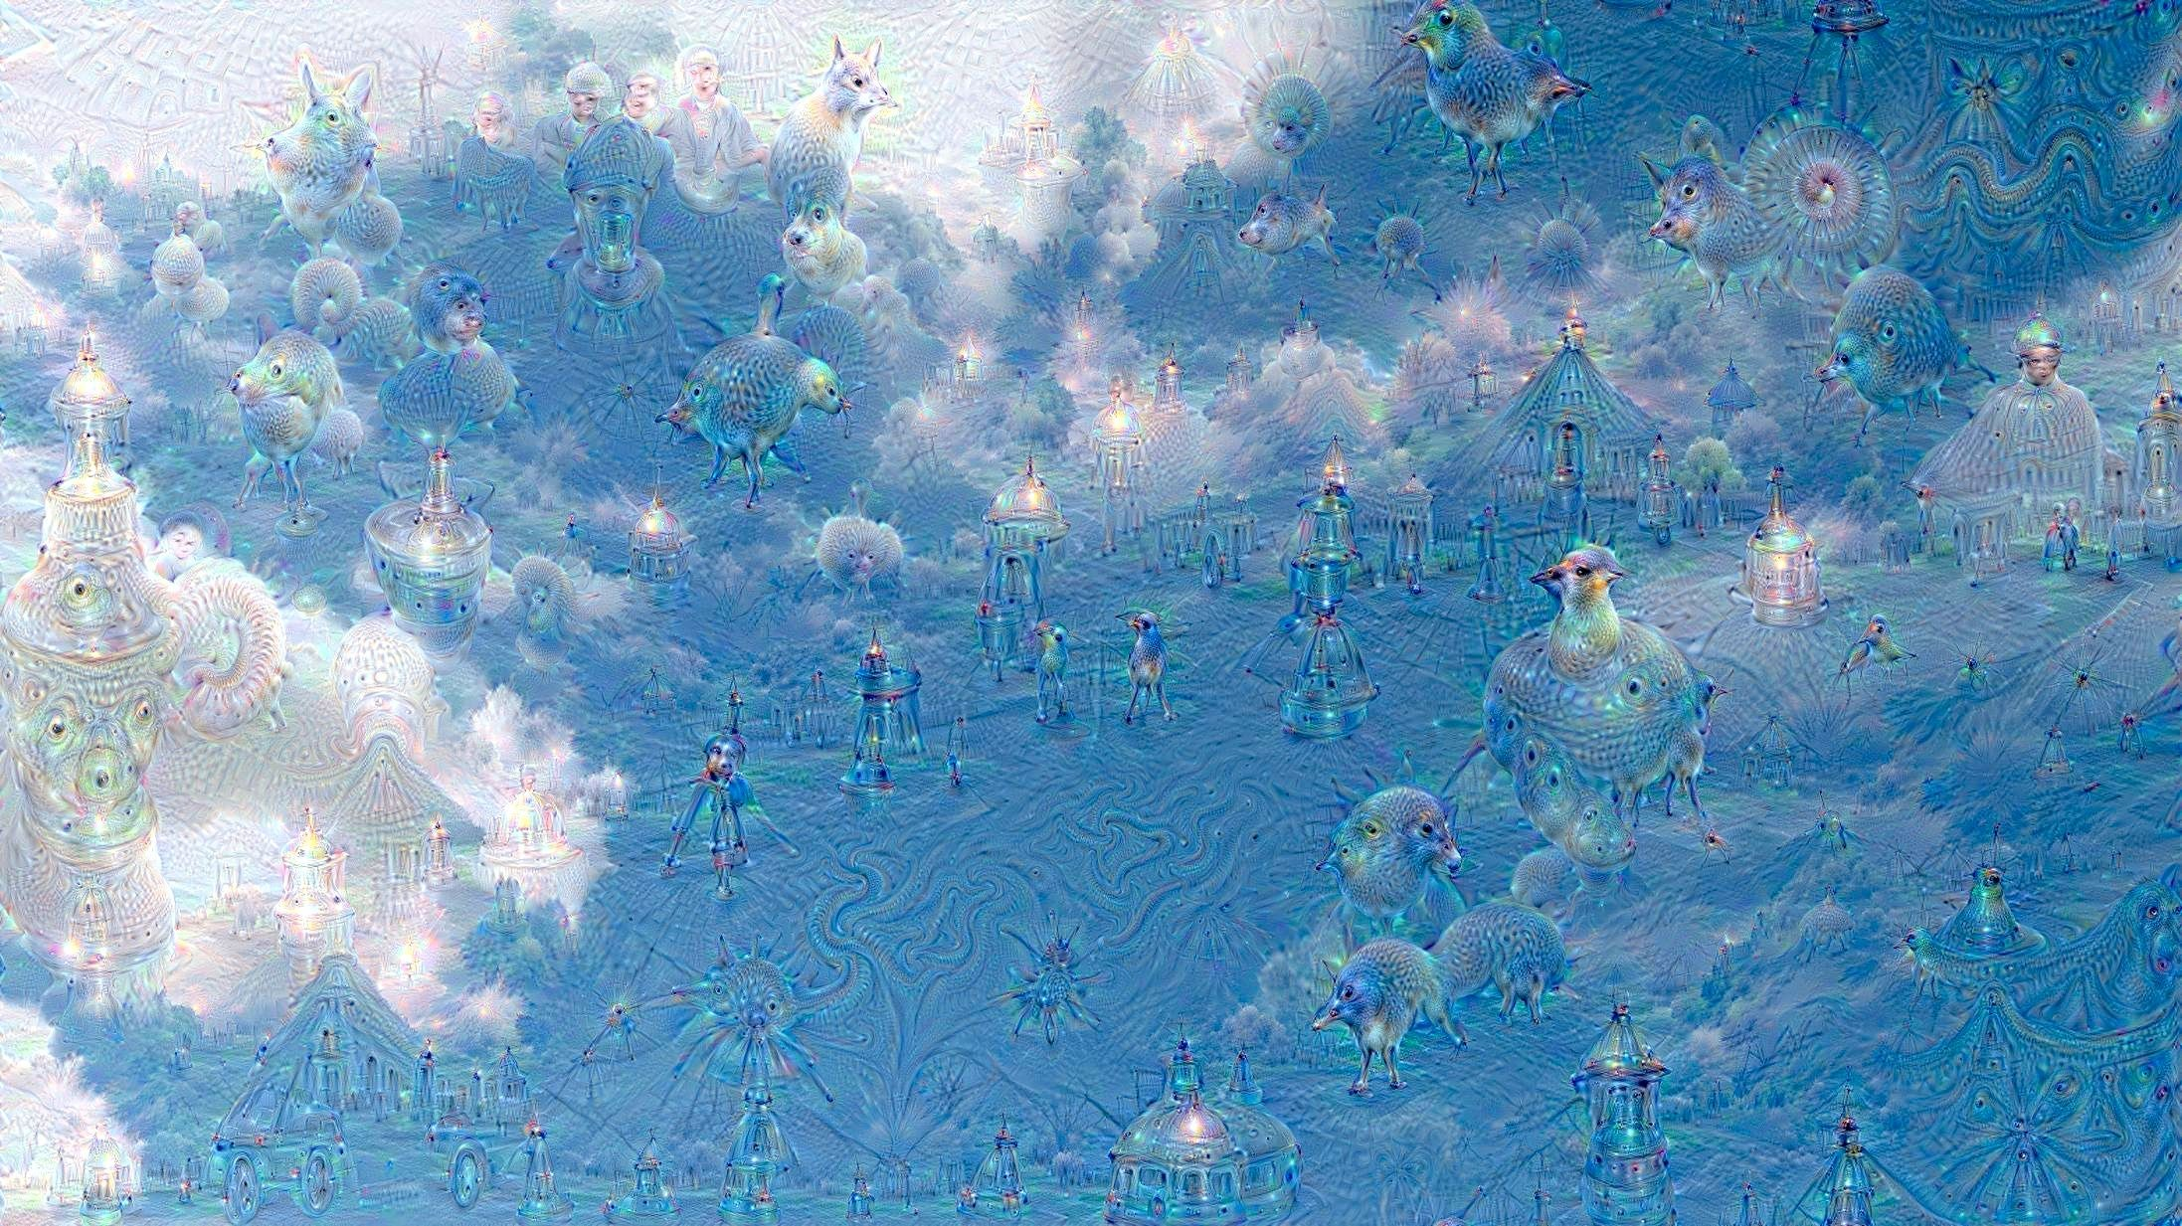
Notes:
Vyssi level – objavuju sa nejake objekty na ktore je network natrenovany
Vacsinou pes lebo imagenet ma z 1000 kategorii 200 kategorii psov

Slide 42
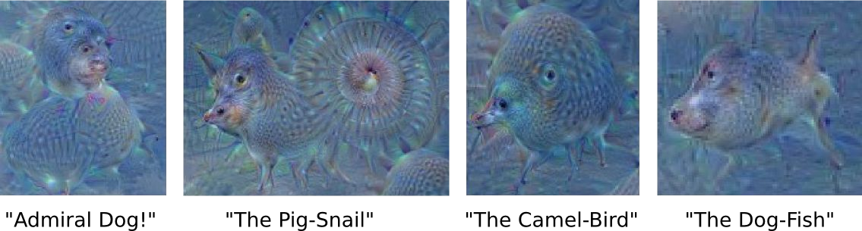

Slide 43
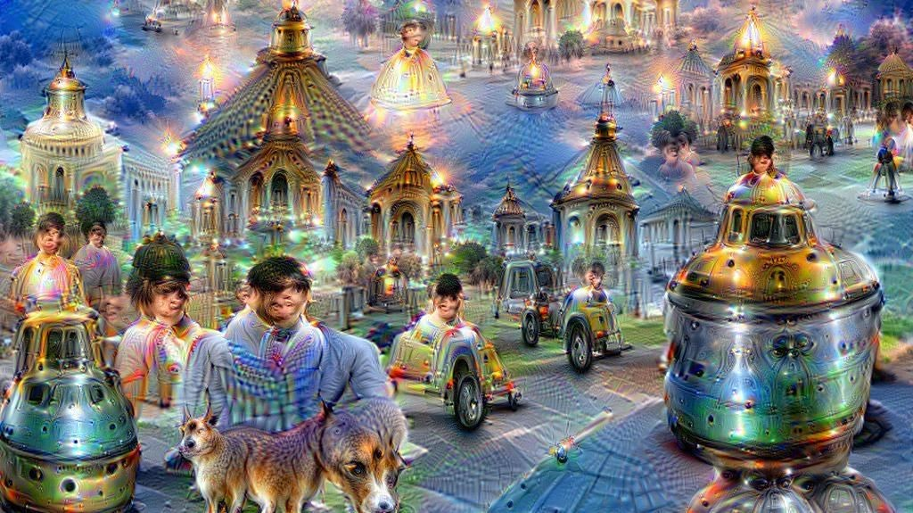

Slide 44
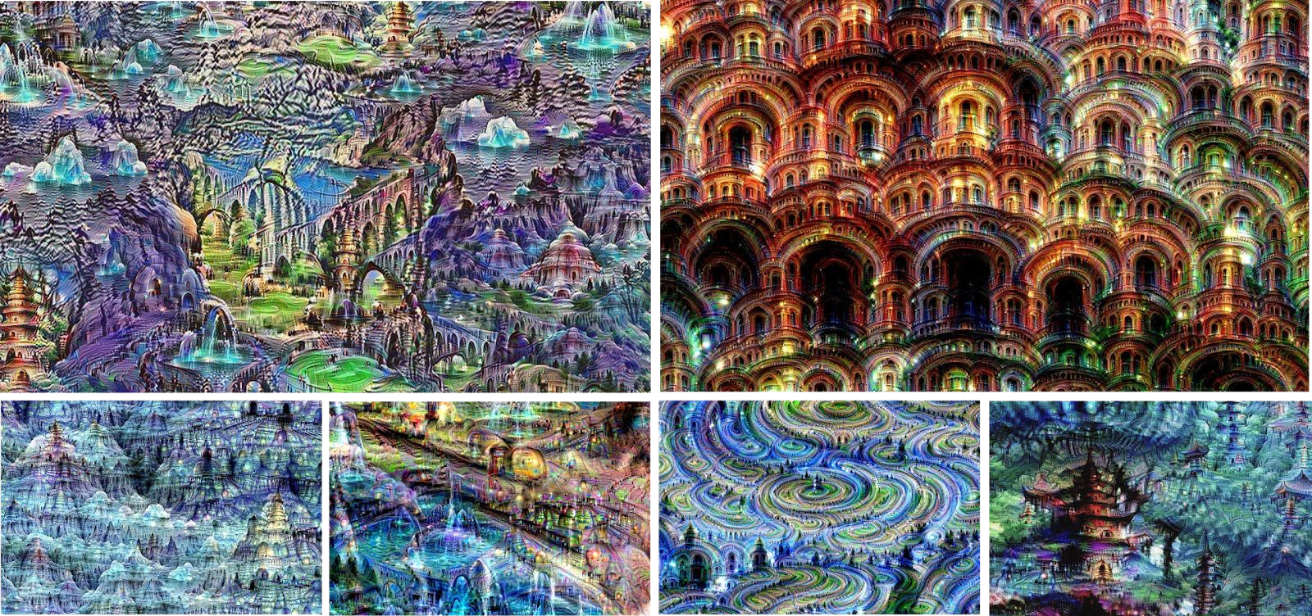
Notes:
Trenovane na datasete MIT places

Slide 45



Feature Inversion
Given a CNN feature vector for an image, find a new image that:
Matches the given feature vector
“looks natural” (image prior regularization)
Given feature vector Features of new image
Total Variation regularizer (encourages spatial smoothness)
Mahendran and Vedaldi, “Understanding Deep Image Representations by Inverting Them”, CVPR 2015

Slide 46
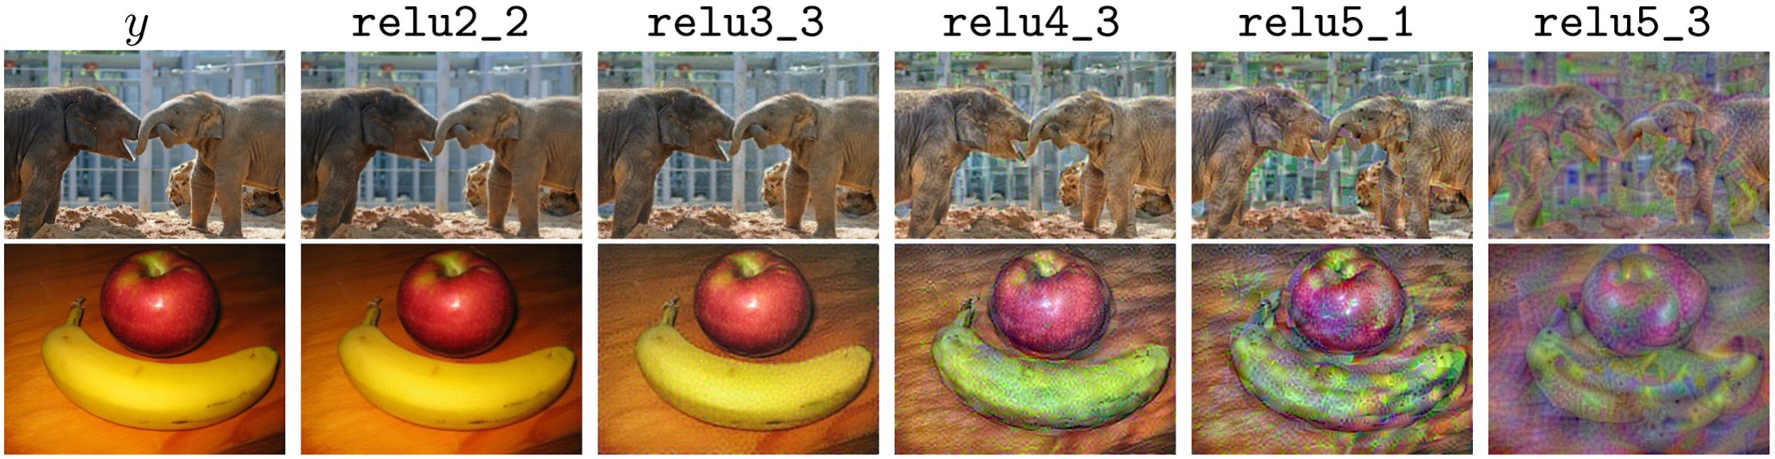
Feature Inversion
Reconstructing from different layers of VGG-16
Mahendran and Vedaldi, “Understanding Deep Image Representations by Inverting Them”, CVPR 2015
Figure from Johnson, Alahi, and Fei-Fei, “Perceptual Losses for Real-Time Style Transfer and Super-Resolution”, ECCV 2016. Copyright Springer, 2016.

Slide 47
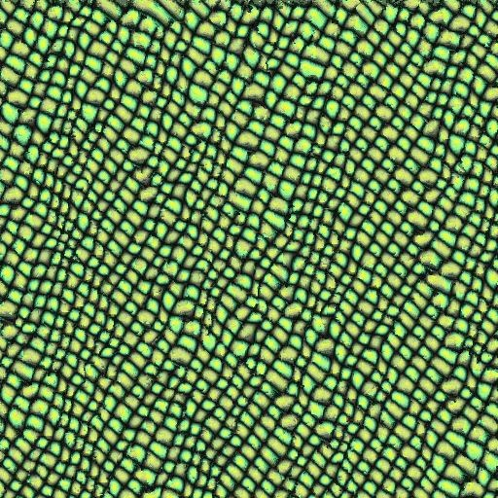

Texture Synthesis
Given a sample patch of some texture, can we generate a bigger image of the same texture?
Input
Output

Slide 48


Texture Synthesis: Nearest Neighbor
Generate pixels one at a time in scanline order; form neighborhood of already generated pixels and copy nearest neighbor from input
Wei and Levoy, “Fast Texture Synthesis using Tree-structured Vector Quantization”, SIGGRAPH 2000 Efros and Leung, “Texture Synthesis by Non-parametric Sampling”, ICCV 1999

Slide 49
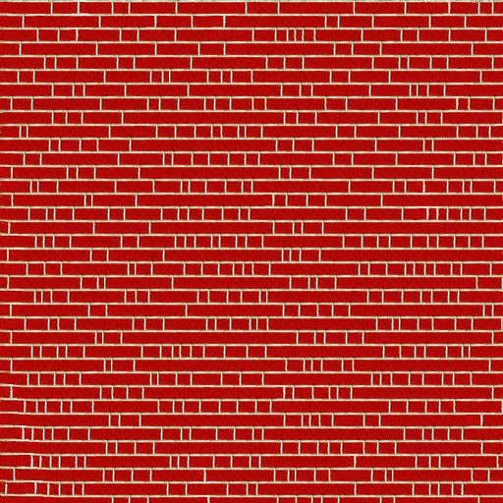
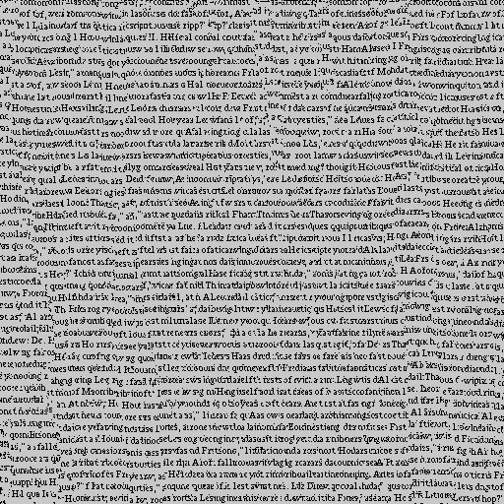
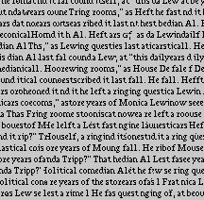


Texture Synthesis: Nearest Neighbor
Notes:
Na vacsich to nefunguje dobre

Slide 50


Neural Texture Synthesis: Gram Matrix
C
H
w
This image is in the public domain.
Each layer of CNN gives C x H x W tensor of features; H x W grid of C-dimensional vectors
Notes:
Given a set of vectors (points in ), the Gram matrix is the matrix of all possible inner products of , i.e.,

Slide 51
Neural Texture Synthesis: Gram Matrix
C
C
H
C
w
This image is in the public domain.
Each layer of CNN gives C x H x W tensor of features; H x W grid of C-dimensional vectors
Outer product of two C-dimensional vectors gives C x C matrix measuring co-occurrence

Slide 52
Neural Texture Synthesis: Gram Matrix
C
H
w
This image is in the public domain.
Each layer of CNN gives C x H x W tensor of features; H x W grid of C-dimensional vectors
Outer product of two C-dimensional vectors gives C x C matrix measuring co-occurrence
Average over all HW pairs of vectors, giving
Gram matrix of shape C x C

Slide 53
Neural Texture Synthesis: Gram Matrix
C
H
w
This image is in the public domain.
Each layer of CNN gives C x H x W tensor of features; H x W grid of C-dimensional vectors
Outer product of two C-dimensional vectors gives C x C matrix measuring co-occurrence
Average over all HW pairs of vectors, giving
Gram matrix of shape C x C
Efficient to compute; reshape features from
C x H x W to =C x HW
then compute G = FF^{T}
Notes:
Zahodili sme space information z feature space, 2.nd order statistic of the features

Slide 54




Neural Texture Synthesis
Pretrain a CNN on ImageNet (VGG-19)
Run input texture forward through CNN, record activations on every layer; layer i gives feature map of shape C_{i} × H_{i} × W_{i}
At each layer compute the Gram matrix
giving outer product of features:
(shape C_{i} × C_{i})
4. Initialize generated image from random
noise
5. Pass generated image through CNN, compute Gram matrix on each layer
6. Compute loss: weighted sum of L2 distance between Gram matrices
7. Backprop to get gradient on image
8. Make gradient step on image
9. GOTO 5
Gatys, Ecker, and Bethge, “Texture Synthesis Using Convolutional Neural Networks”, NIPS 2015

Slide 55
Neural Texture Synthesis
Pretrain a CNN on ImageNet (VGG-19)
Run input texture forward through CNN, record activations on every layer; layer i gives feature map of shape C_{i} × H_{i} × W_{i}
At each layer compute the Gram matrix
giving outer product of features:
(shape C_{i} × C_{i})
4. Initialize generated image from random
noise
5. Pass generated image through CNN, compute Gram matrix on each layer
6. Compute loss: weighted sum of L2 distance between Gram matrices
7. Backprop to get gradient on image
8. Make gradient step on image
9. GOTO 5
Gatys, Ecker, and Bethge, “Texture Synthesis Using Convolutional Neural Networks”, NIPS 2015

Slide 56
Neural Texture Synthesis
Pretrain a CNN on ImageNet (VGG-19)
Run input texture forward through CNN, record activations on every layer; layer i gives feature map of shape C_{i} × H_{i} × W_{i}
At each layer compute the Gram matrix
giving outer product of features:
(shape C_{i} × C_{i})
4. Initialize generated image from random
noise
5. Pass generated image through CNN, compute Gram matrix on each layer
6. Compute loss: weighted sum of L2 distance between Gram matrices
7. Backprop to get gradient on image
8. Make gradient step on image
9. GOTO 5
Gatys, Ecker, and Bethge, “Texture Synthesis Using Convolutional Neural Networks”, NIPS 2015

Slide 57
Neural Texture Synthesis
Pretrain a CNN on ImageNet (VGG-19)
Run input texture forward through CNN, record activations on every layer; layer i gives feature map of shape C_{i} × H_{i} × W_{i}
At each layer compute the Gram matrix
giving outer product of features:
(shape C_{i} × C_{i})
4. Initialize generated image from random
noise
5. Pass generated image through CNN, compute Gram matrix on each layer
6. Compute loss: weighted sum of L2 distance between Gram matrices
7. Backprop to get gradient on image
8. Make gradient step on image
9. GOTO 5
Gatys, Ecker, and Bethge, “Texture Synthesis Using Convolutional Neural Networks”, NIPS 2015

Slide 58




Neural Texture Synthesis
Reconstructing texture from higher layers recovers larger features from the input texture

Slide 59

Neural Texture Synthesis : Texture = Artwork
Texture synthesis (Gram reconstruction)
Figure from Johnson, Alahi, and Fei-Fei, “Perceptual Losses for Real-Time Style Transfer and
Super-Resolution”, ECCV 2016. Copyright Springer, 2016.

Slide 60

Neural Texture Synthesis : Texture = Artwork
Texture synthesis (Gram reconstruction)
Feature reconstruction
Figure from Johnson, Alahi, and Fei-Fei, “Perceptual Losses for Real-Time Style Transfer and
Super-Resolution”, ECCV 2016. Copyright

Slide 61


Neural Style Transfer
Content Image
Style Image
+
This image is licensed under CC-BY 3.0
Starry Night by Van Gogh is in the public domain
Gatys, Ecker, and Bethge, “Image style transfer using convolutional neural networks”, CVPR 2016

Slide 62

Neural Style Transfer
Content Image
Style Image
Style Transfer!
+
=
This image is licensed under CC-BY 3.0
Starry Night by Van Gogh is in the public domain
This image copyright Justin Johnson, 2015. Reproduced with permission.
Gatys, Ecker, and Bethge, “Image style transfer using convolutional neural networks”, CVPR 2016

Slide 63





Style image
Output image (Start with noise)
Content image
Gatys, Ecker, and Bethge, “Image style transfer using convolutional neural networks”, CVPR 2016
Figure adapted from Johnson, Alahi, and Fei-Fei, “Perceptual Losses for Real-Time Style Transfer and Super-Resolution”, ECCV 2016. .
Notes:
Kombinacia texture synteseis a features recontruction

Slide 64
Style image
Output image
Content image
Gatys, Ecker, and Bethge, “Image style transfer using convolutional neural networks”, CVPR 2016
Figure adapted from Johnson, Alahi, and Fei-Fei, “Perceptual Losses for Real-Time Style Transfer and Super-Resolution”, ECCV 2016. .

Slide 65













Slide 66


Neural Style Transfer
Example outputs from Justin Johnson implementation, 2015 (in Torch)
Gatys, Ecker, and Bethge, “Image style transfer using convolutional neural networks”, CVPR 2016.

Slide 67

Neural Style Transfer
More weight to content loss
More weight to style loss

Slide 68

Neural Style Transfer
Resizing style image before running style transfer algorithm can transfer different types of features
Larger style image
Smaller style image

Slide 69




Neural Style Transfer: Multiple Style Images
Mix style from multiple images by taking a weighted average of Gram matrices

Slide 70


Slide 71


Slide 72


Slide 73


Slide 74
Neural Style Transfer
Problem: Style transfer requires many forward / backward passes through VGG; very slow!

Slide 75
Neural Style Transfer
Problem: Style transfer requires many forward / backward passes through VGG; very slow!
Solution: Train another neural network to perform style transfer for us!

Slide 76

Fast Style Transfer
Train a feedforward network for each style
Use pretrained CNN to compute same losses as before
After training, stylize images using a single forward pass
80
Johnson, Alahi, and Fei-Fei, “Perceptual Losses for Real-Time Style Transfer and Super-Resolution”, ECCV 2016

Slide 77


Fast Style Transfer
Slow Fast Slow Fast
Johnson, Alahi, and Fei-Fei, “Perceptual Losses for Real-Time Style Transfer and Super-Resolution”, ECCV 2016 Figure copyright Springer, 2016.
https://github.com/jcjohnson/fast-neural-style

Slide 78

Fast Style Transfer
Replacing batch normalization with Instance Normalization improves results
Ulyanov et al, “Texture Networks: Feed-forward Synthesis of Textures and Stylized Images”, ICML 2016 Ulyanov et al, “Instance Normalization: The Missing Ingredient for Fast Stylization”, arXiv 2016

Slide 79

One Network, Many Styles
Dumoulin, Shlens, and Kudlur, “A Learned Representation for Artistic Style”, ICLR 2017.

Slide 80


One Network, Many Styles
Use the same network for multiple styles using conditional instance normalization: learn separate scale and shift parameters per style
Single network can blend styles after training
Dumoulin, Shlens, and Kudlur, “A Learned Representation for Artistic Style”, ICLR 2017.
Figure copyright Vincent Dumoulin, Jonathon Shlens, and Manjunath Kudlur, 2016; reproduced with permission.

Slide 81
Summary
Many methods for understanding CNN representations
Activations: Nearest neighbors, Dimensionality reduction, maximal patches, occlusion
Gradients: Saliency maps, class visualization, fooling images, feature inversion
Fun: DeepDream, Style Transfer.

