Slide 1
Neurónové siete pre počítačové videnie šk.r. 2019-20
4 Konvolučné neurónové siete
Doc. RNDr. Milan Ftáčnik, CSc.
RNDr. Zuzana Černeková, PhD.

Slide 2



Linear score function:
2-layer Neural Network
Opakovanie: Neural Networks
x
h
W1
W2
s
3072
100
10
Notes:
Skladanie vrstiev na seba s nejakou nelinearitou pomedzi ne
Problem – semantic gap

Slide 3
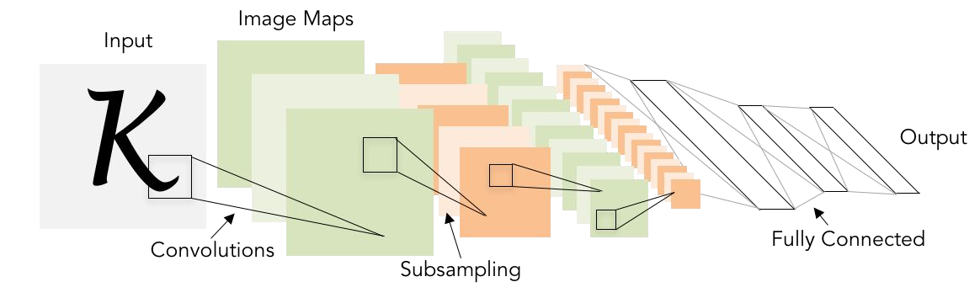
Next: Convolutional Neural Networks
Notes:
Chcu zachovat special (priestorovu) structure

Slide 4
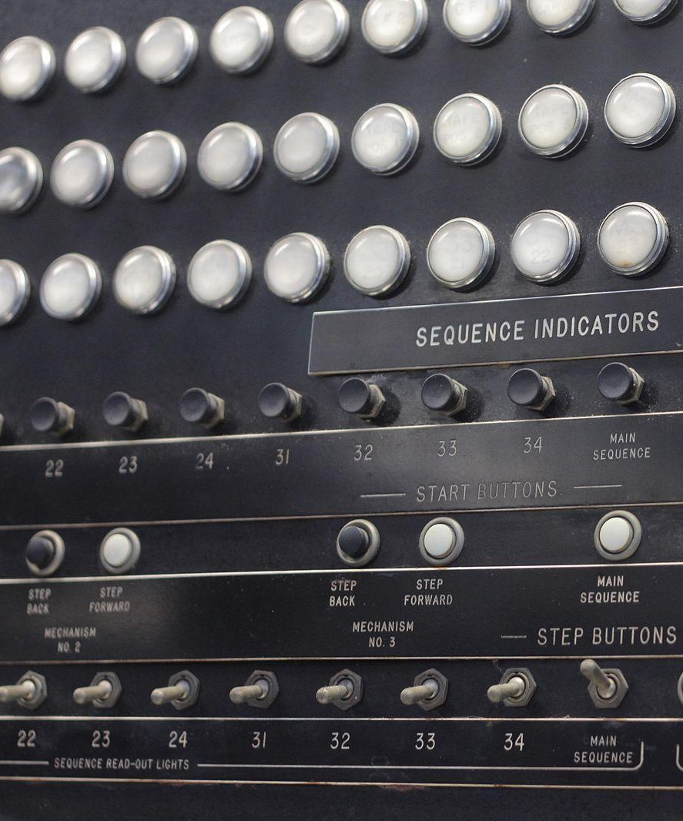

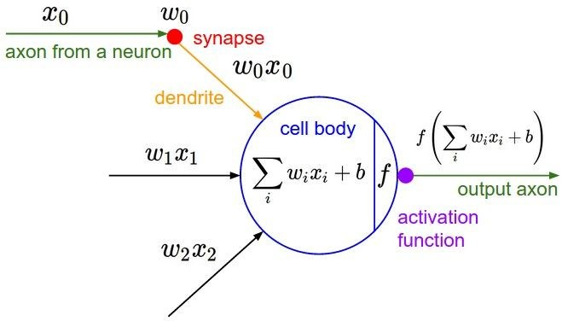
A bit of history...
The Mark I Perceptron machine was the first implementation of the perceptron algorithm.
The machine was connected to a camera that used 20×20 cadmium sulfide photocells to produce a 400-pixel image.
recognized
letters of the alphabet
update rule:
Frank Rosenblatt, ~1957: Perceptron
Update rule similar to back prop but
No back propagation yet

Slide 5
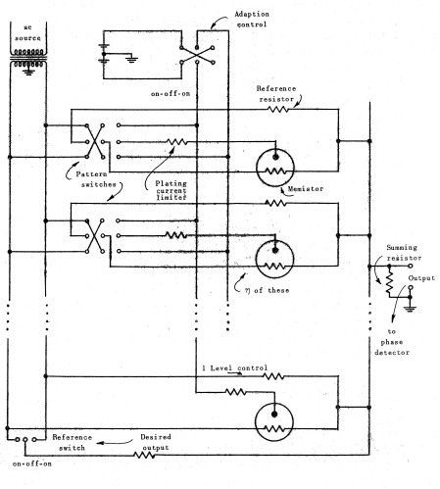
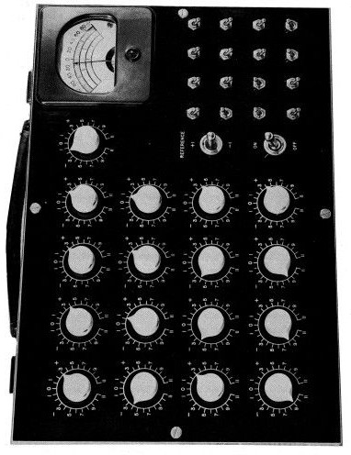
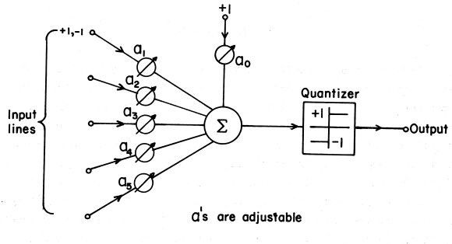
A bit of history...
Widrow and Hoff, ~1960: Adaline/Madaline
Multilayer perceptron
Starting to look like NN layers
Still no back prop.

Slide 6
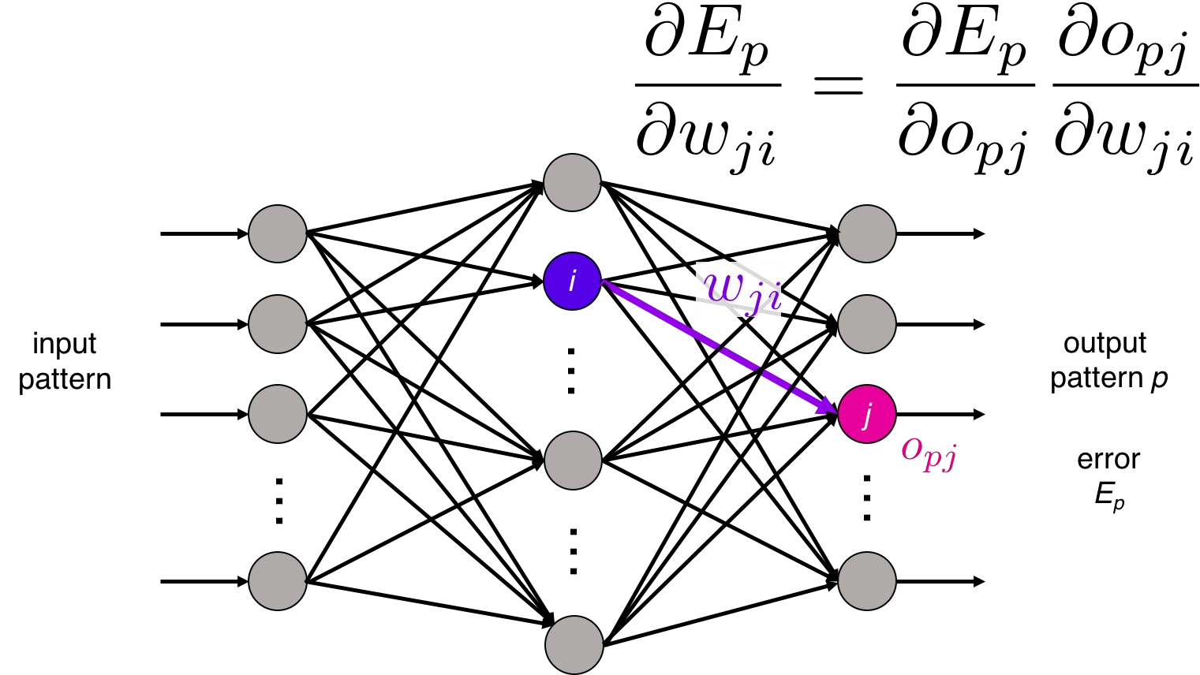
A bit of history...
recognizable math
Rumelhart et al., 1986: First time back-propagation became popular

Slide 7
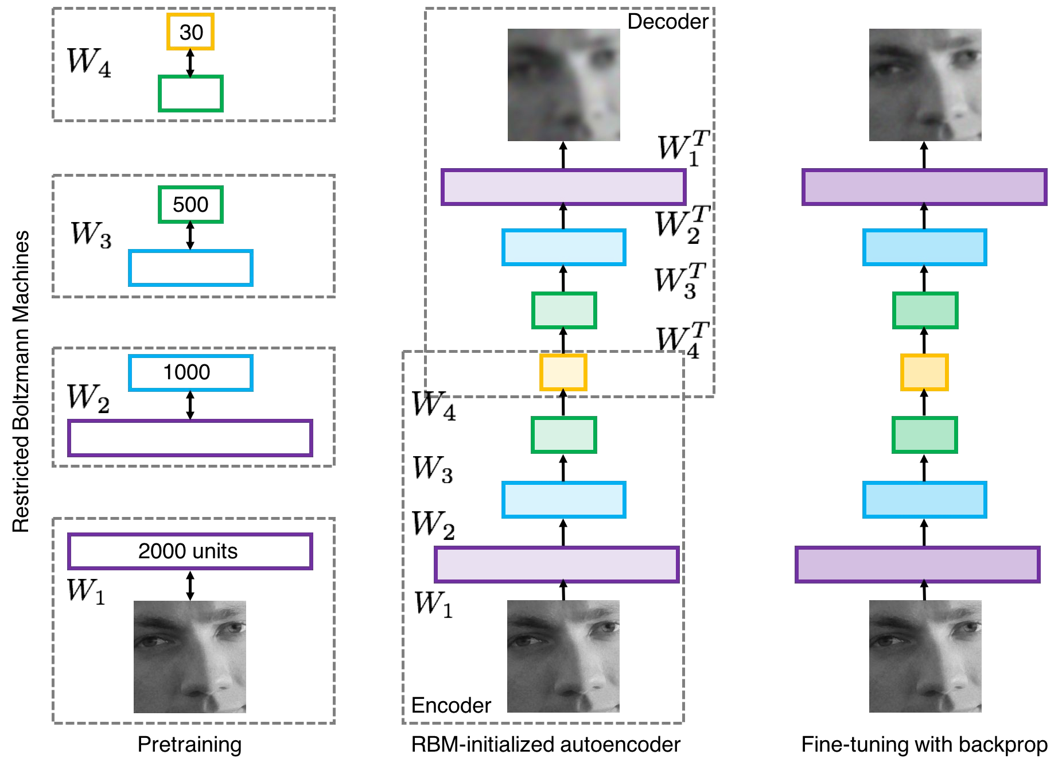
A bit of history...
[Hinton and Salakhutdinov 2006]
Reinvigorated research in Deep Learning
Notes:
Deep learning ale nie v dnesnej podobe

Slide 8
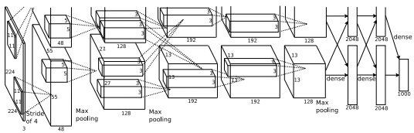
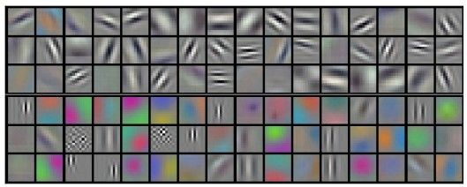
First strong results
Acoustic Modeling using Deep Belief Networks
Abdel-rahman Mohamed, George Dahl, Geoffrey Hinton, 2010
Context-Dependent Pre-trained Deep Neural Networks for Large Vocabulary Speech Recognition
George Dahl, Dong Yu, Li Deng, Alex Acero, 2012
Imagenet classification with deep convolutional neural networks
Alex Krizhevsky, Ilya Sutskever, Geoffrey E Hinton, 2012
“AlexNet”

Slide 9
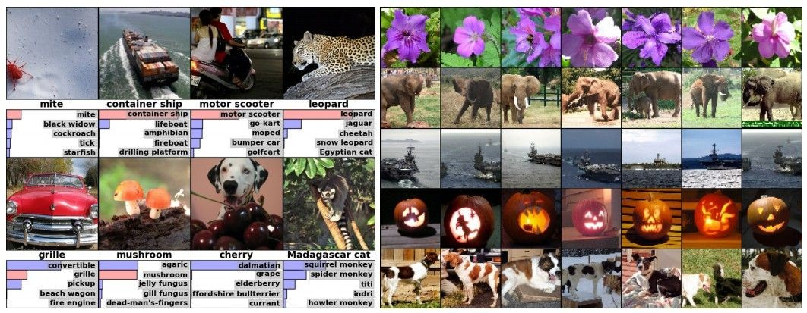
Fast-forward to today: ConvNets are everywhere
Classification Retrieval

Slide 10
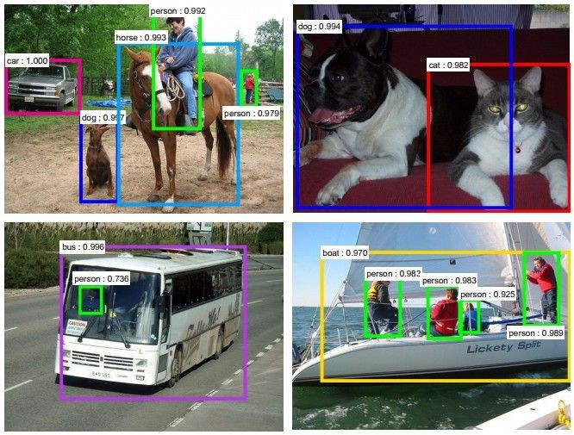
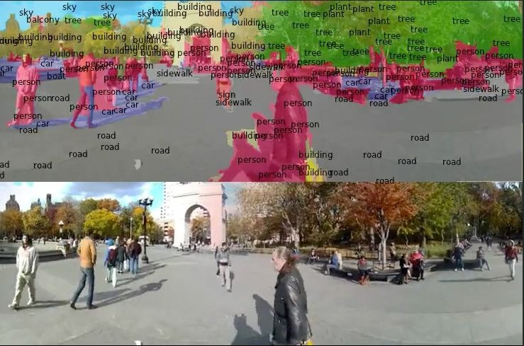
Fast-forward to today: ConvNets are everywhere
Detection Segmentation
[Farabet et al., 2012]
[Faster R-CNN: Ren, He, Girshick, Sun 2015]

Slide 11
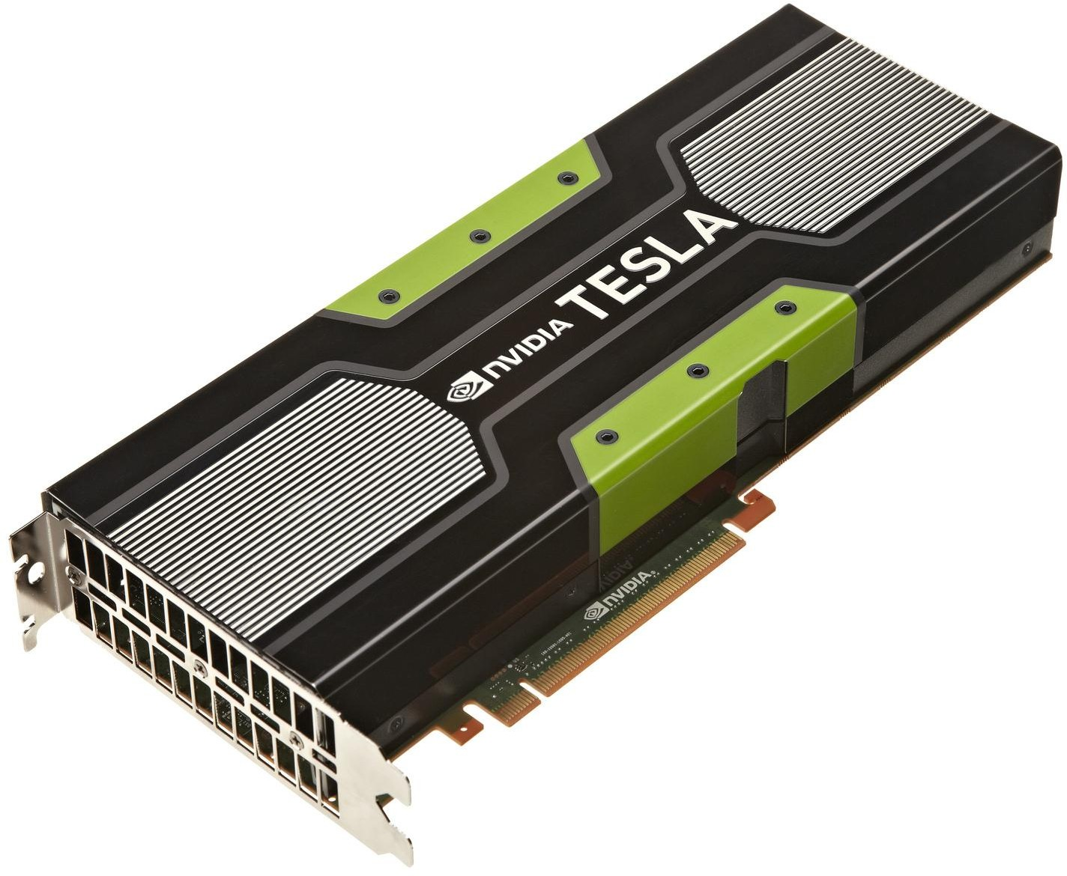
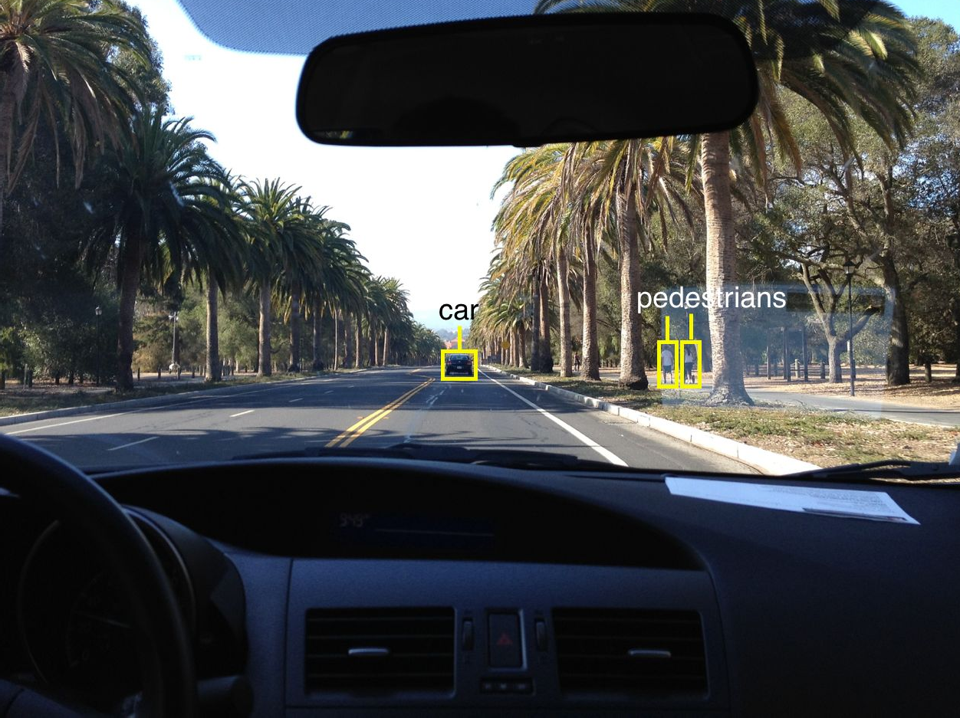
Fast-forward to today: ConvNets are everywhere
self-driving cars
NVIDIA Tesla line
Note that for embedded systems a typical setup would involve NVIDIA Tegras, with integrated GPU and ARM-based CPU cores.

Slide 12
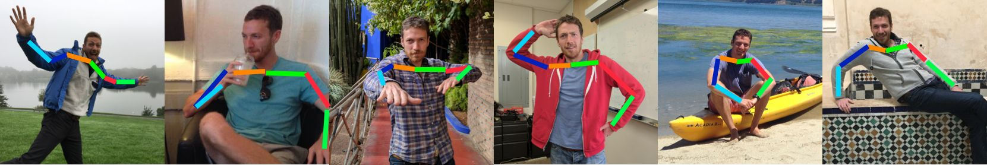
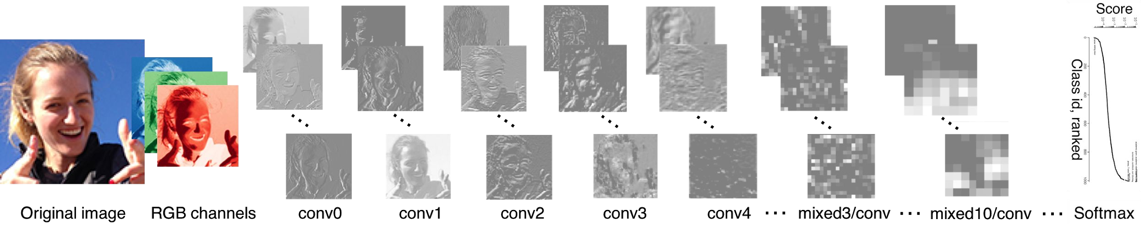
Fast-forward to today: ConvNets are everywhere
Pose recognition – even non standard poses
Face recognition from an image

Slide 13
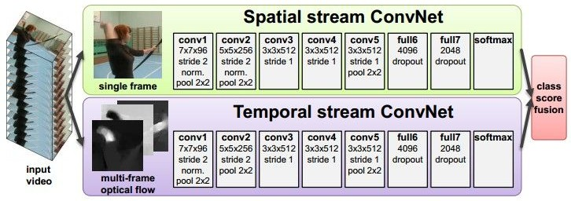
Fast-forward to today: ConvNets are everywhere
Video classification using temporal information

Slide 14
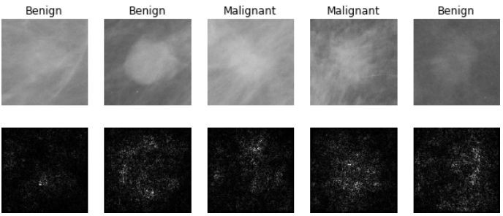
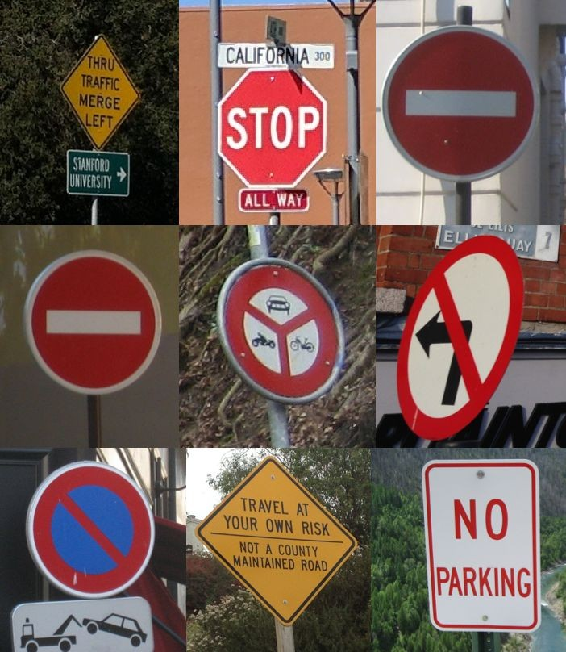
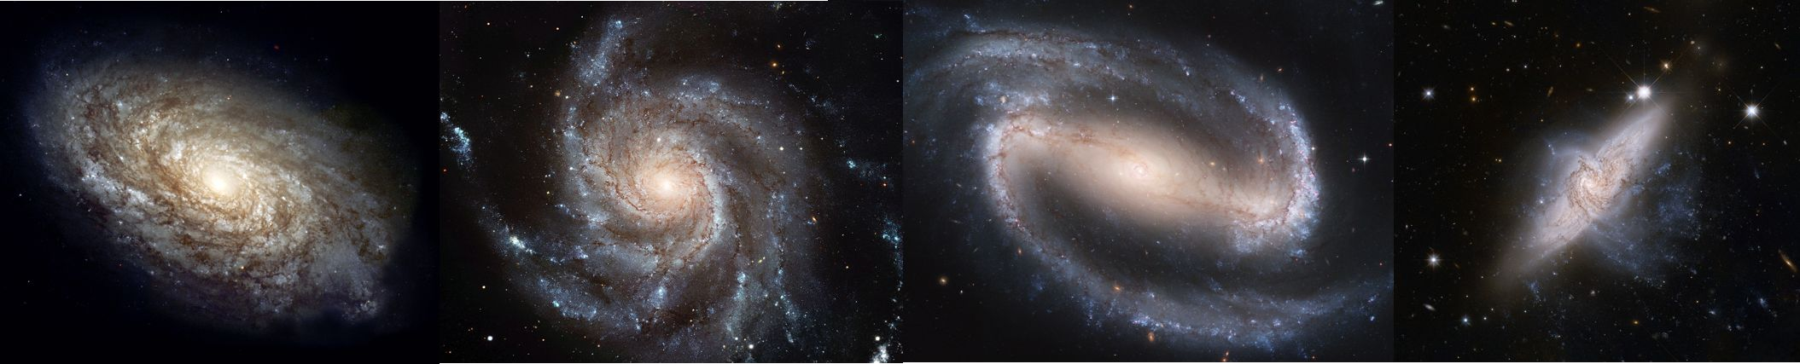
Fast-forward to today: ConvNets are everywhere
Interpretation and diagnostics of medical images
Street sign recognition
[Levy et al. 2016]
Classification of galaxies
[Sermanet et al. 2011] [Ciresan et al.]
[Dieleman et al. 2014]

Slide 15
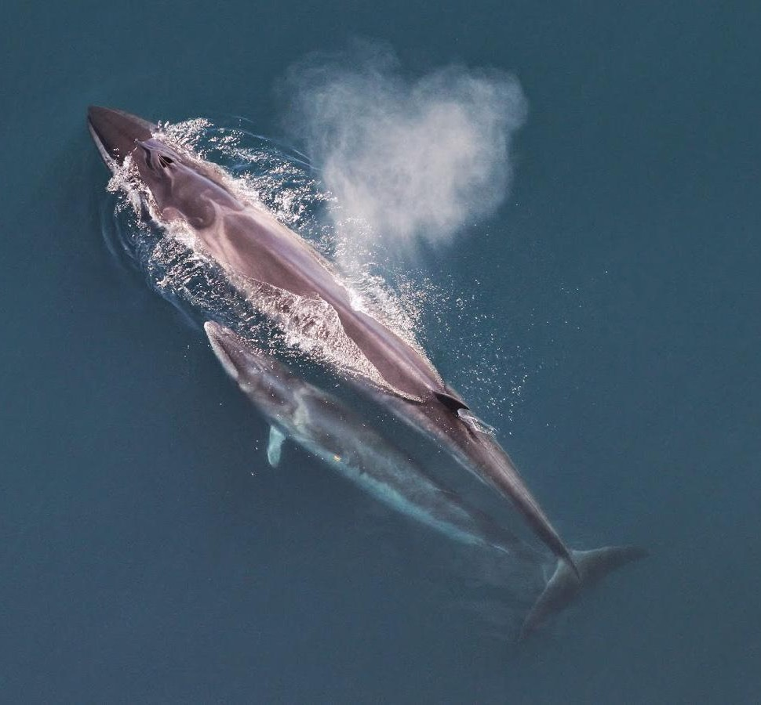
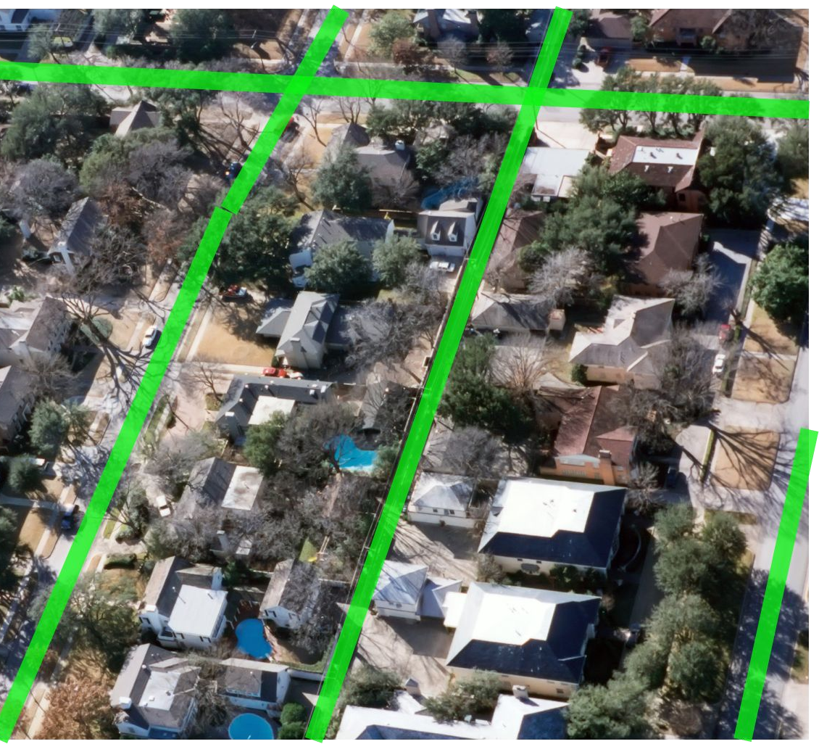
Fast-forward to today: ConvNets are everywhere
Whale recognition,
Kaggle Challenge
Streets and buildings recognition in areal maps

Slide 16
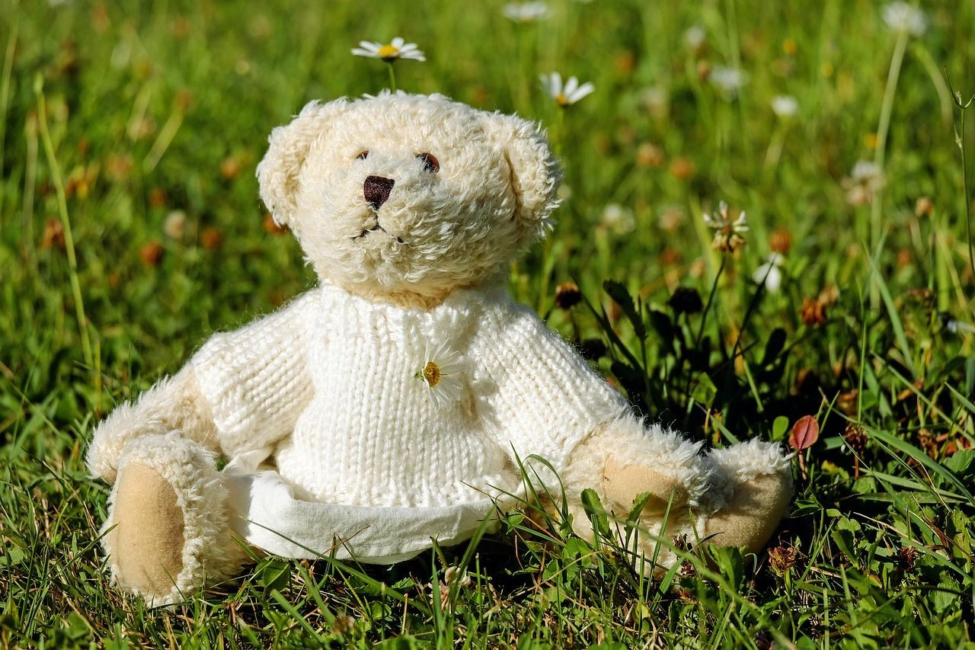
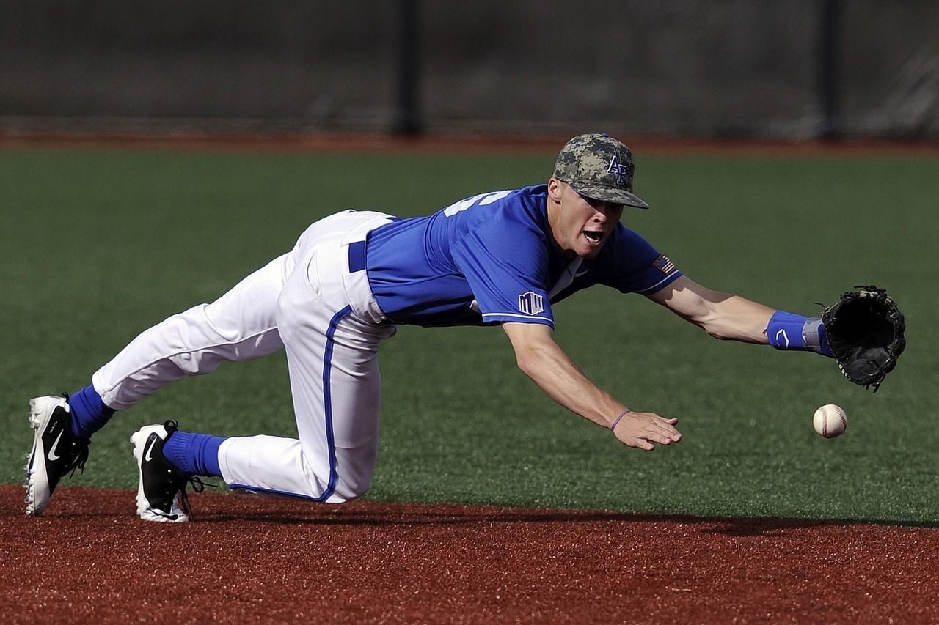

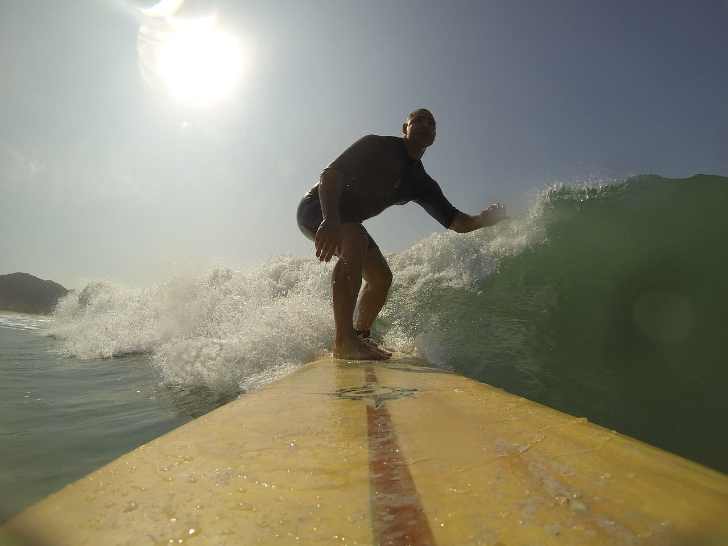

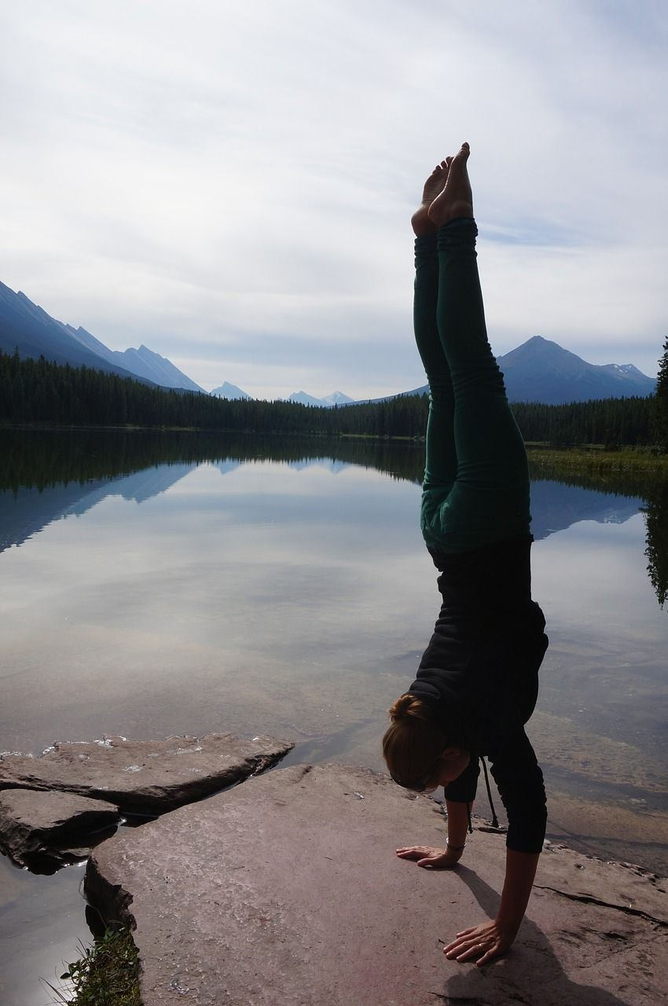
Fast-forward to today: ConvNets are everywhere
Image Captioning
No errors
Minor errors
Somewhat related
[Vinyals et al., 2015] [Karpathy and Fei-Fei, 2015]
A white teddy bear sitting in the grass
A man in a baseball uniform throwing a ball
A woman is holding a cat in her hand
A man riding a wave on top of a surfboard
A cat sitting on a suitcase on the floor
A woman standing on a beach holding a surfboard

Slide 17
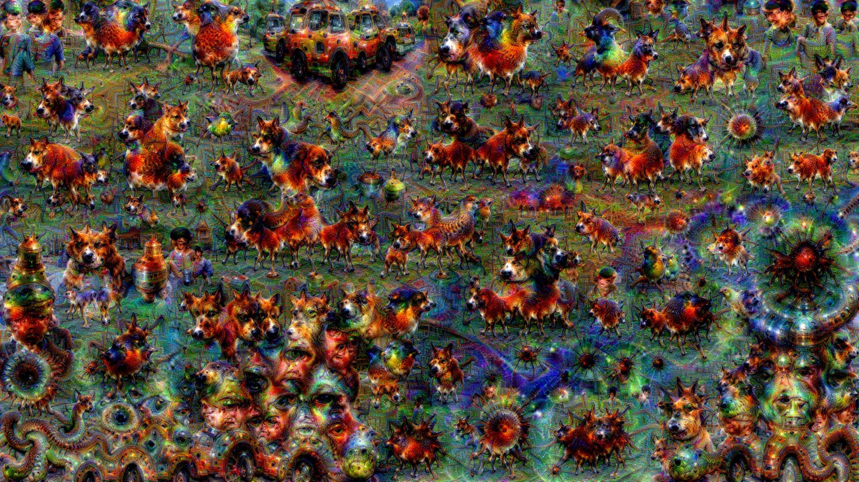
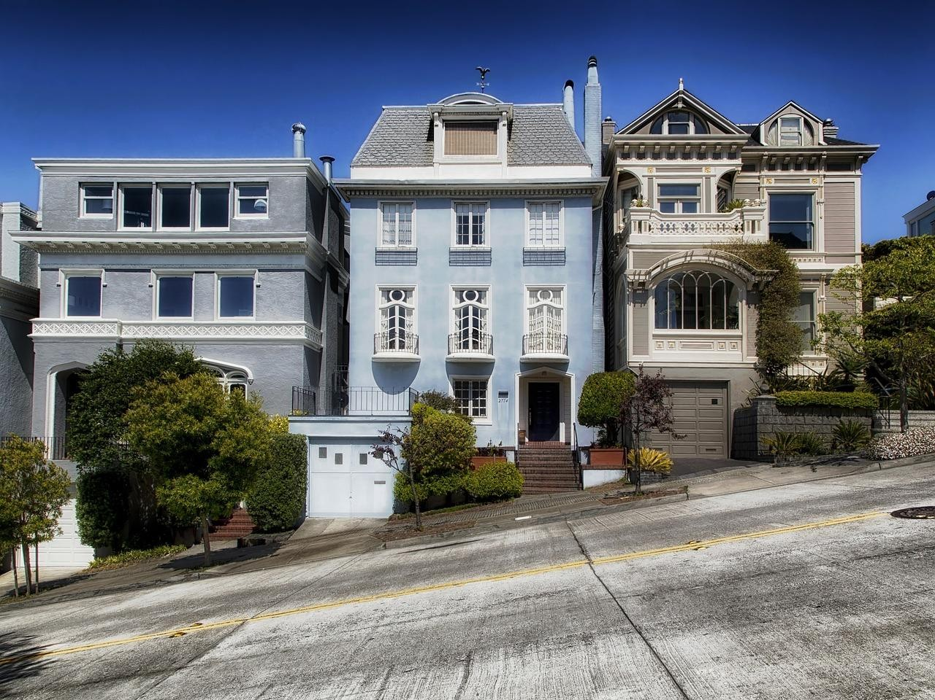
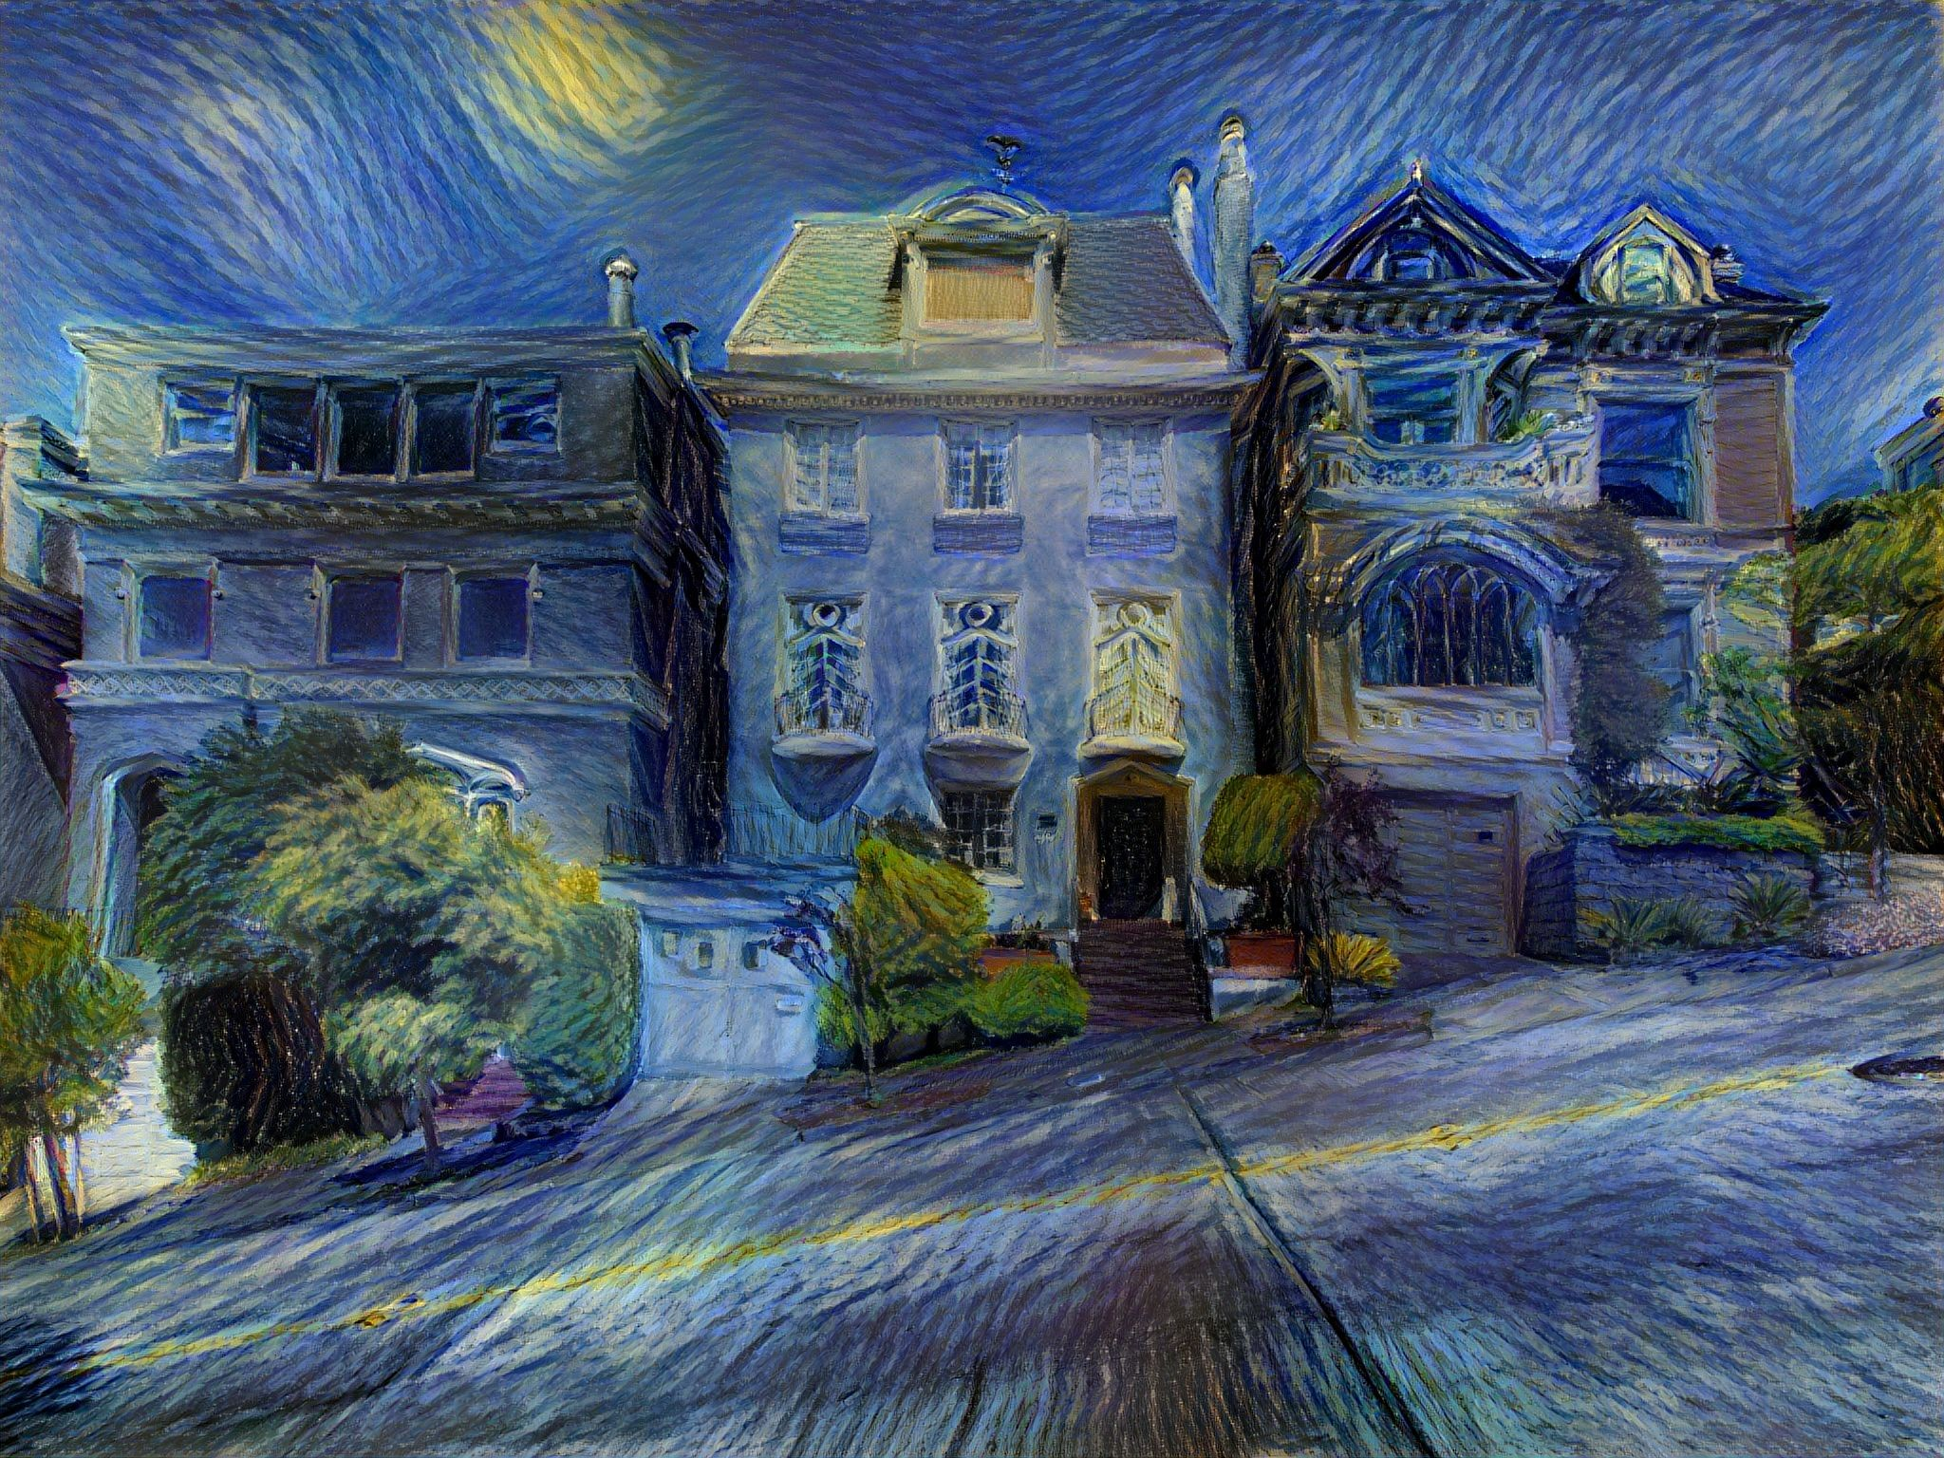
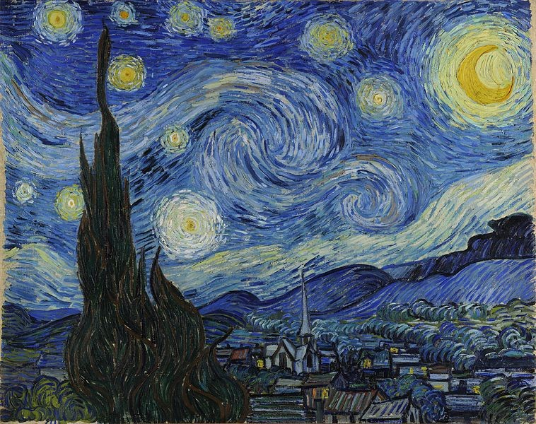
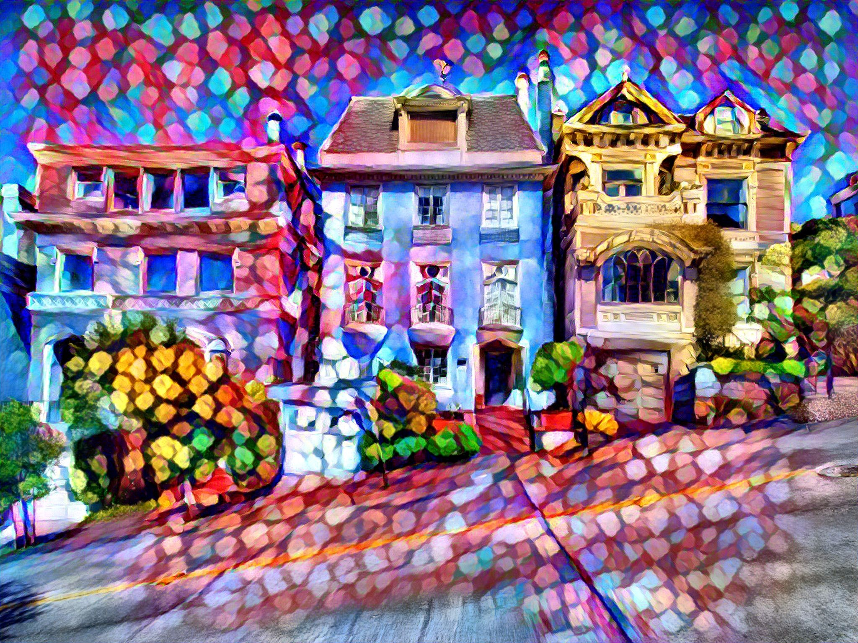
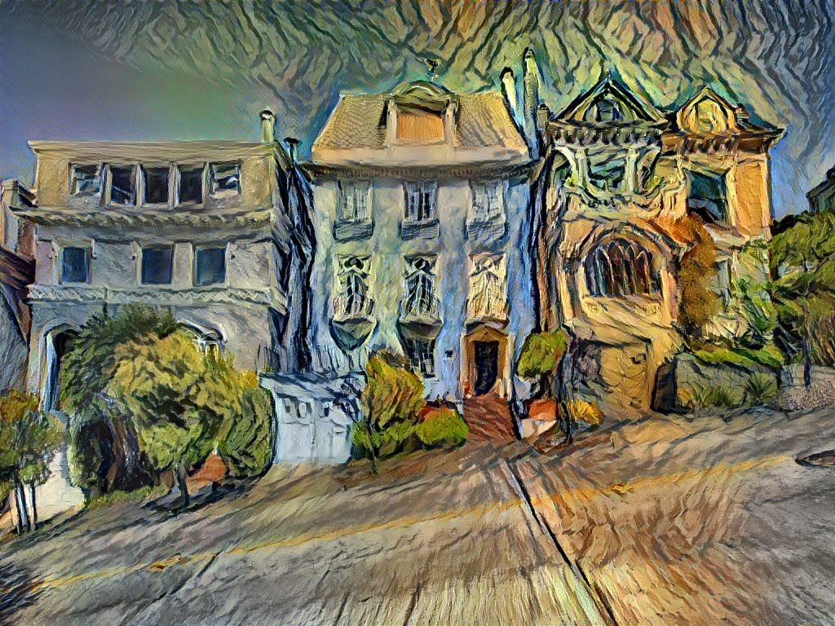
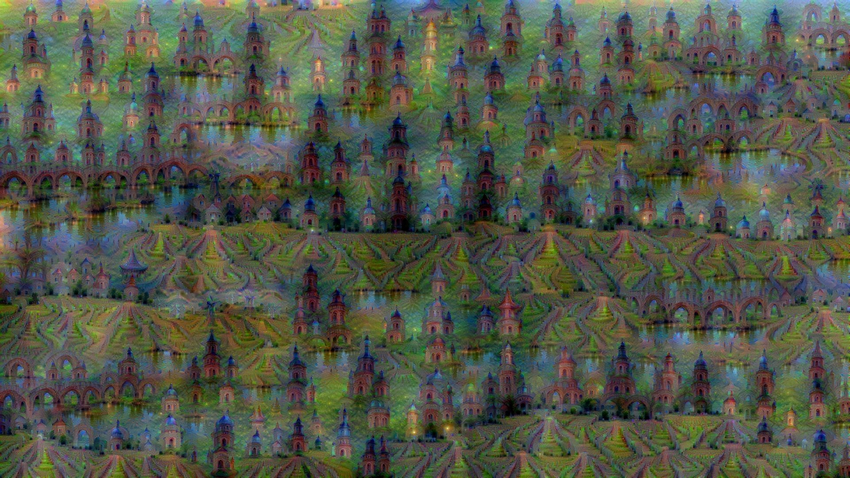
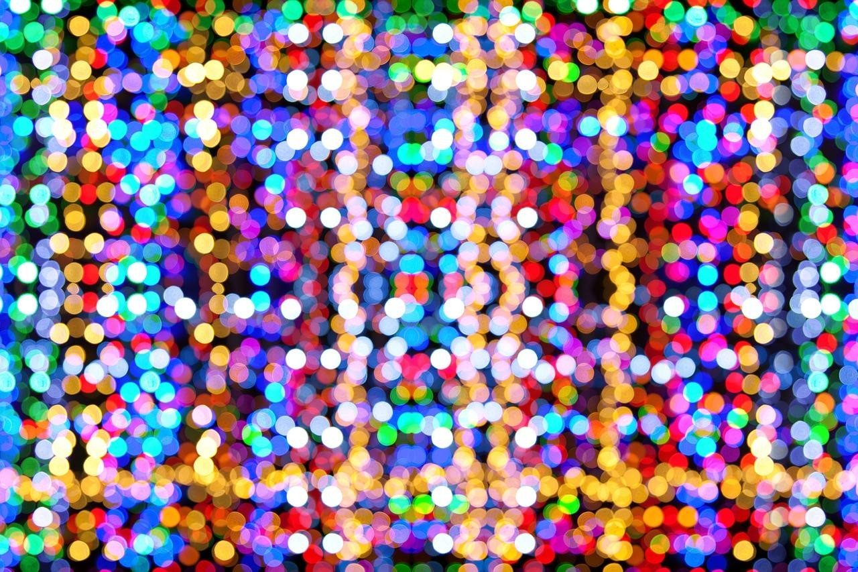
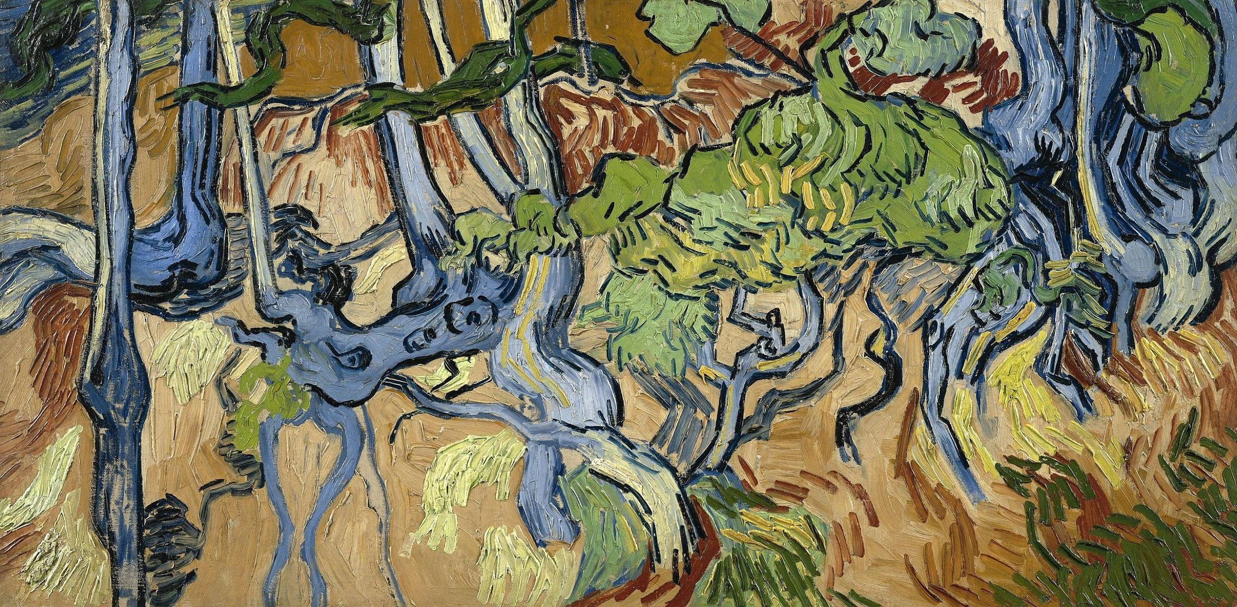
Fast-forward to today: ConvNets are everywhere
Generated art work
Art style transfer

Slide 18
Convolutional Neural Networks

Slide 19
Konvolučné neurónové siete
Označujú sa aj CNNs/ConvNets
Sú podobné tradičným neurónovým sieťam:
  majú tiež váhy nastavované učením a prahové hodnoty
  každý neurón má svoje vstupy, vykonáva s nimi skalárny súčin, obyčajne nasledovaný nejakou nelinearitou
  majú tiež cenovú funkciu na poslednej (plne prepojenej) vrstve

Slide 20
Konvolučné neurónové siete II
Rozdiel je v tom, že pri CNN robíme explicitný predpoklad, že na vstupe sú obrazy
To umožní efektívnejšie dopredné fungovanie siete a výrazné zníženie počtu parametrov v sieti
Zníženie počtu získame zdieľaním parametrov - voľbou rovnakých váh všetkých neurónov v jednom reze danej vrstvy siete

Slide 21
Prehľad architektúry siete
Tradičné neurónové siete:
  Každá skrytá vrstva pozostáva z množiny neurónov, kde každý neurón je plne prepojený so všetkými neurónmi predošlej vrstvy, funguje samostatne a nezdieľa žiadne prepojenia
Nevedia sa škálovať na celé obrazy:
  Pri databáze CIFAR-10, ktorá má obrazy 32x32x3 má jeden neurón 3.072 váh, pri obraze 200x200x3 to bude už 120.000 váh – to vedie na preučenie

Slide 22
Prehľad architektúry CNN
Vrstvy v CNN sú organizované v 3D: majú šírku, výšku a hĺbku (tu slovo hĺbka vyjadruje hĺbku jednej aktivačnej vrstvy, nie hĺbku siete)
Aj vstup má svoj objem: už spomínaný CIFAR-10 má rozmery 32x32x3 (šírka x dĺžka x hĺbka, kde hĺbka je počet farebných kanálov)
Pri CNN sú neuróny prepojené len na malú oblasť neurónov v predošlej vrstve

Slide 23
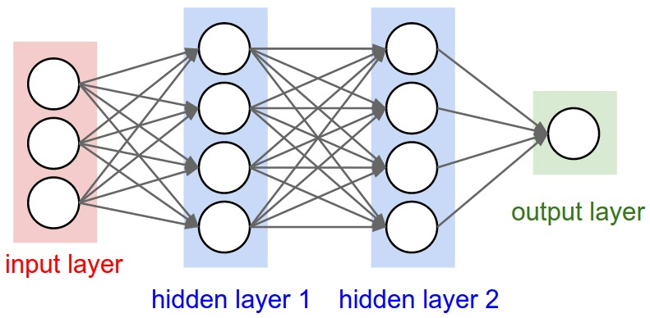
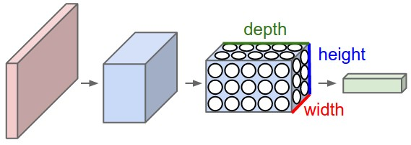
Prehľad architektúry CNN III
Tradičná trojvrst- vová neurónová sieť
Každá vrstva v CNN transformuje 3D vstupný objem na 3D výstupný objem aktivácií neurónov

Slide 24

Fully Connected Layer
32x32x3 image -> stretch to 3072 x 1
input
activation
1
1
3072
10 x 3072
weights
10

Slide 25
Fully Connected Layer
32x32x3 image -> stretch to 3072 x 1
input
activation
1
1
3072
10 x 3072
weights
10
1 number:
the result of taking a dot product between a row of W and the input (a 3072-dimensional dot product)

Slide 26
Convolution Layer
32x32x3 image -> preserve spatial structure
32
height
32
width
3
depth

Slide 27
Convolution Layer
32x32x3 image
5x5x3 filter
32
Convolve the filter with the image
i.e. “slide over the image spatially, computing dot products”
32
3

Slide 28
Convolution Layer
Filters always extend the full depth of the input volume
32x32x3 image
5x5x3 filter
32
Convolve the filter with the image
i.e. “slide over the image spatially, computing dot products”
32
3

Slide 29


Convolution Layer
32x32x3 image 5x5x3 filter
32
1 number:
the result of taking a dot product between the filter and a small 5x5x3 chunk of the image
(i.e. 5*5*3 = 75-dimensional dot product + bias)
32
3

Slide 30
Convolution Layer
activation map
32x32x3 image 5x5x3 filter
32
28
convolve (slide) over all spatial locations
28
32
1
3

Slide 31
Convolution Layer
consider a second, green filter
activation maps
32x32x3 image 5x5x3 filter
32
28
convolve (slide) over all spatial locations
28
32
1
3

Slide 32
For example, if we had 6 5x5x3 filters, we’ll get 6 separate activation maps:
activation maps
32
28
Convolution Layer
32
28
3
6
We stack these up to get a “new image” of size 28x28x6!

Slide 33
Preview: ConvNet is a sequence of Convolution Layers, interspersed with activation functions
32
28
CONV, ReLU
e.g. 6 5x5x3 filters
32
28
3
6

Slide 34
Preview: ConvNet is a sequence of Convolution Layers, interspersed with activation functions
32
28
24
….
CONV, ReLU
e.g. 6 5x5x3 filters
CONV, ReLU
e.g. 10 5x5x6 filters
CONV, ReLU
32
28
24
3
6
10

Slide 35
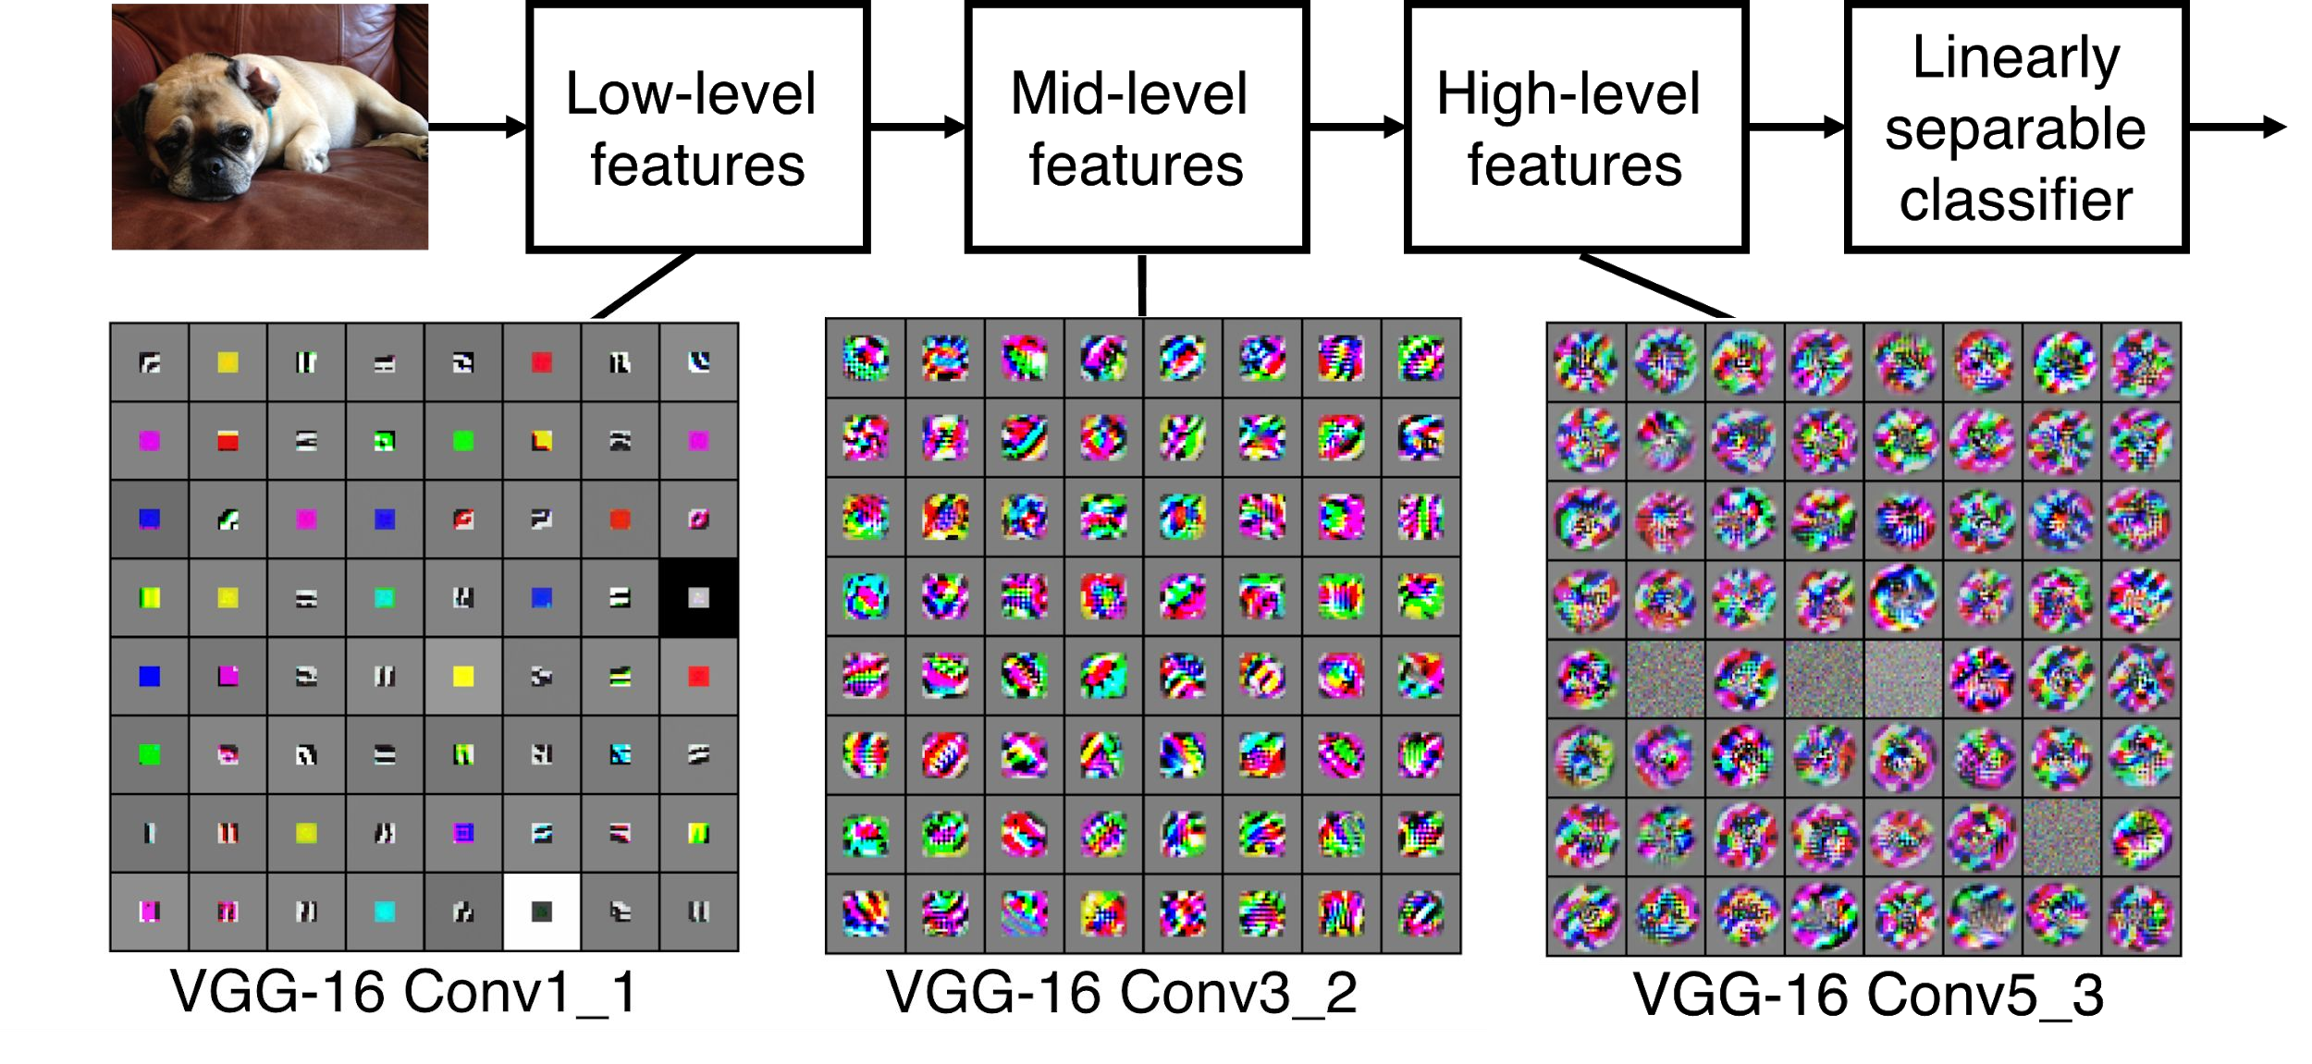
Preview
[Zeiler and Fergus 2013]
Notes:
Kazda bunka je 1 neuron a zobrazeny je obraz ktory ak pride na vstup tak dany neuron sa maximalizuje

Slide 36
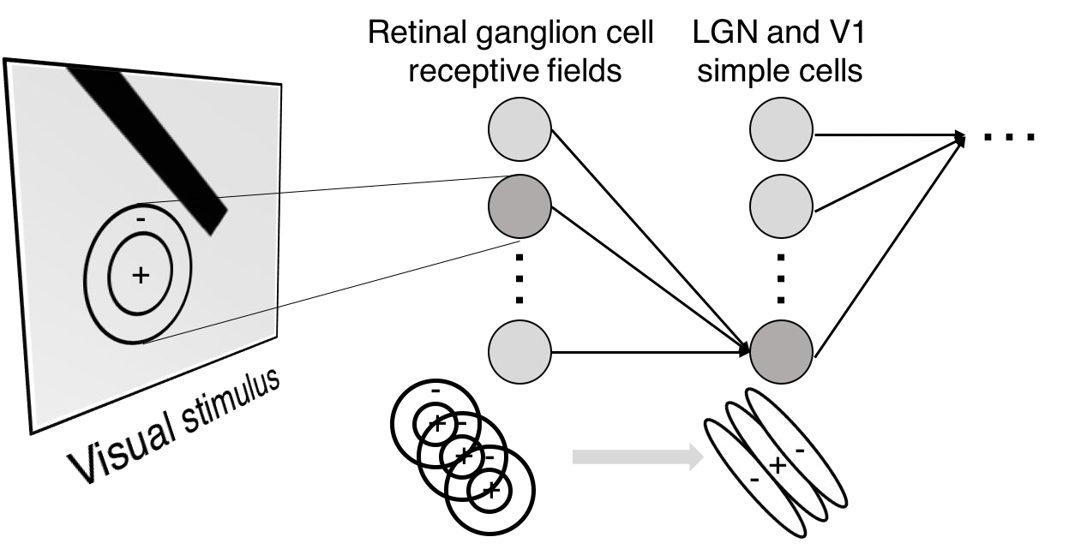
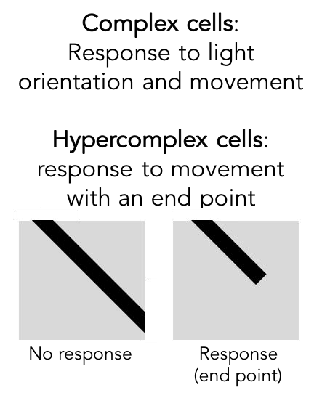
Preview

Slide 37
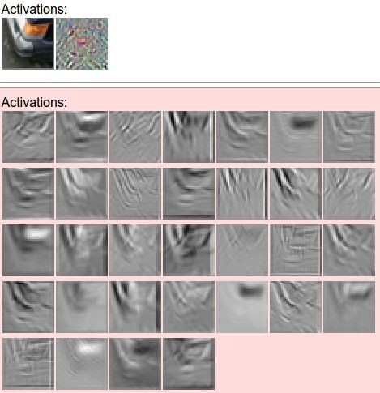

one filter =>
one activation map
example 5x5 filters
(32 total)
We call the layer convolutional because it is related to convolution of two signals:
elementwise multiplication and sum of a filter and the signal (image)

Slide 38
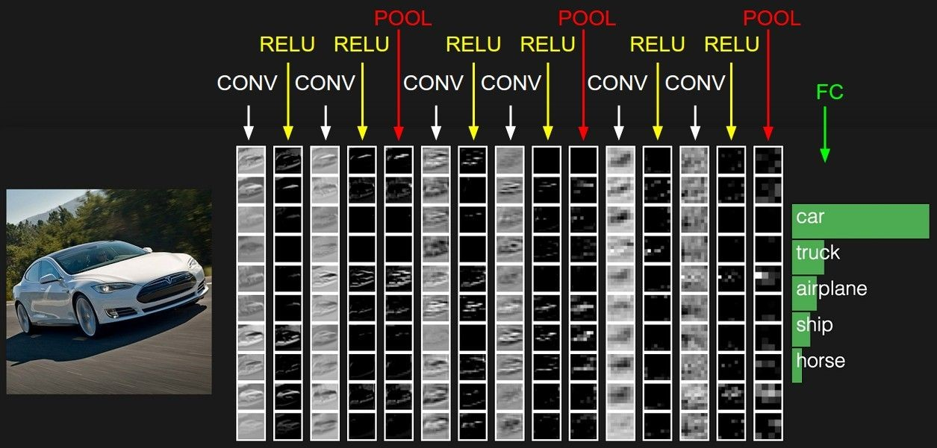
Preview

Slide 39
A closer look at spatial dimensions:
activation map
32x32x3 image 5x5x3 filter
32
28
convolve (slide) over all spatial locations
28
32
1
3

Slide 40
A closer look at spatial dimensions:
7
7x7 input (spatially) assume 3x3 filter
7

Slide 41
A closer look at spatial dimensions:
7
7x7 input (spatially) assume 3x3 filter
7

Slide 42
A closer look at spatial dimensions:
7
7x7 input (spatially) assume 3x3 filter
7

Slide 43
A closer look at spatial dimensions:
7
7x7 input (spatially) assume 3x3 filter
7

Slide 44
A closer look at spatial dimensions:
7
7x7 input (spatially) assume 3x3 filter
7
=> 5x5 output

Slide 45
A closer look at spatial dimensions:
7
7x7 input (spatially) assume 3x3 filter applied with stride 2
7

Slide 46
A closer look at spatial dimensions:
7
7x7 input (spatially) assume 3x3 filter applied with stride 2
7

Slide 47
A closer look at spatial dimensions:
7
7x7 input (spatially) assume 3x3 filter applied with stride 2
=> 3x3 output!
7

Slide 48
A closer look at spatial dimensions:
7
7x7 input (spatially) assume 3x3 filter applied with stride 3?
7

Slide 49
A closer look at spatial dimensions:
7
7x7 input (spatially) assume 3x3 filter applied with stride 3?
7

Slide 50
A closer look at spatial dimensions:
7
7x7 input (spatially) assume 3x3 filter applied with stride 3?
7
doesn’t fit!
cannot apply 3x3 filter on 7x7 input with stride 3.

Slide 51
N
Output size:
(N - F) / stride + 1
 |  |  | F
 | F
e.g. N = 7, F = 3:
stride 1 => (7 - 3)/1 + 1 = 5
stride 2 => (7 - 3)/2 + 1 = 3
stride 3 => (7 - 3)/3 + 1 = 2.33 :\
N

Slide 52
In practice: Common to zero pad the border
e.g. input 7x7
3x3 filter, applied with stride 1
pad with 1 pixel border => what is the output?
0 | 0 | 0 | 0 | 0 | 0
0
0
0
0
(recall:)
(N - F) / stride + 1

Slide 53
In practice: Common to zero pad the border
e.g. input 7x7
3x3 filter, applied with stride 1
pad with 1 pixel border => what is the output?
7x7 output!
0 | 0 | 0 | 0 | 0 | 0
0
0
0
0

Slide 54
In practice: Common to zero pad the border
e.g. input 7x7
3x3 filter, applied with stride 1
pad with 1 pixel border => what is the output?
7x7 output!
in general, common to see CONV layers with stride 1, filters of size FxF, and zero-padding with (F-1)/2. (will preserve size spatially)
e.g. F = 3 => zero pad with 1
F = 5 => zero pad with 2
F = 7 => zero pad with 3
0 | 0 | 0 | 0 | 0 | 0
0
0
0
0

Slide 55
Remember back to…
E.g. 32x32 input convolved repeatedly with 5x5 filters shrinks volumes spatially! (32 -> 28 -> 24 ...). Shrinking too fast is not good, doesn’t work well.
32
28
24
….
CONV, ReLU
e.g. 6 5x5x3 filters
CONV, ReLU
e.g. 10 5x5x6 filters
CONV, ReLU
32
28
24
3
6
10

Slide 56
Examples time:
Input volume: 32x32x3
10 5x5x3 filters with stride 1, pad 2
Output volume size?

Slide 57
Examples time:
Input volume: 32x32x3
10 5x5x3 filters with stride 1, pad 2
Output volume size:
(32+2*2-5)/1+1 = 32 spatially, so
32x32x10

Slide 58
Examples time:
Input volume: 32x32x3
10 5x5x3 filters with stride 1, pad 2
Number of parameters in this layer?

Slide 59
Examples time:
Input volume: 32x32x3
10 5x5x3 filters with stride 1, pad 2
Number of parameters in this layer? each filter has 5*5*3 + 1 = 76 params
=> 76*10 = 760
(+1 for bias)

Slide 60
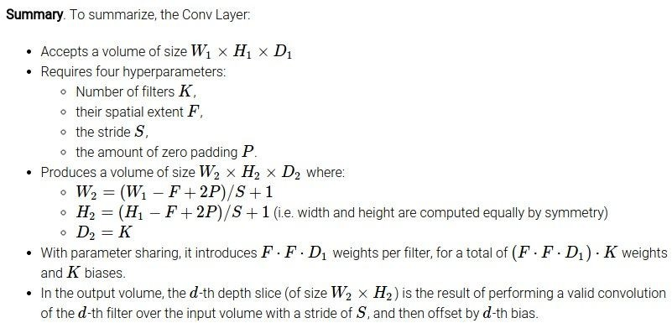

Slide 61
Common settings:
K = (powers of 2, e.g. 32, 64, 128, 512)
- F = 3, S = 1, P = 1
- F = 5, S = 1, P = 2
- F = 5, S = 2, P = ? (whatever fits)
- F = 1, S = 1, P = 0

Slide 62
(btw, 1x1 convolution layers make perfect sense)
1x1 CONV
with 32 filters
56
(each filter has size 1x1x64, and performs
a 64-dimensional dot product)
56
56
56
64
32

Slide 63
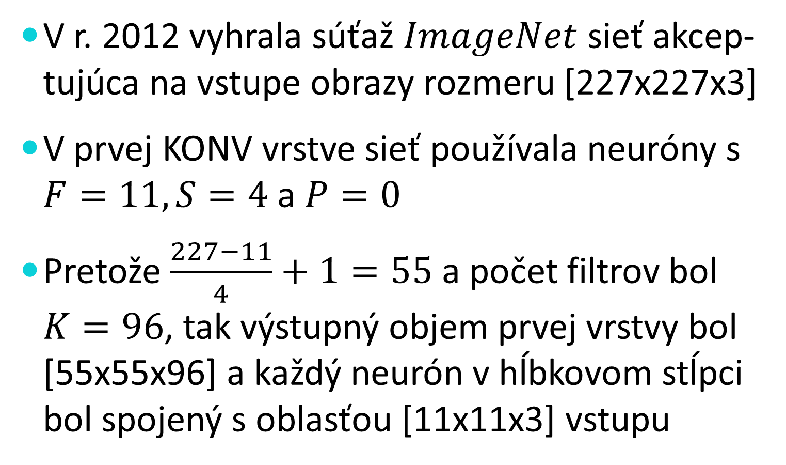
Reálny príklad
V r. 2012 vyhrala súťaž $ImageNet$ sieť akcep-tujúca na vstupe obrazy rozmeru [227x227x3]
V prvej KONV vrstve sieť používala neuróny s $F=11, S=4$ a $P=0$
Pretože $\frac{227−11}{4}+1=55$ a počet filtrov bol $K=96$, tak výstupný objem prvej vrstvy bol [55x55x96] a každý neurón v hĺbkovom stĺpci bol spojený s oblasťou [11x11x3] vstupu
Notes:
Samozrejme každý z 96 neurónov mal iné váhy

Slide 64
Zdieľanie parametrov
V tomto príklade bolo 55*55*96=290,040 neurónov a každý mal 11*11*3=363 váh a jednu prahovú hodnotu. To je 105,705,600 parametrov, čo je príliš veľa
Urobíme predpoklad, že ak chceme skúmať nejakú vlastnosť na nejakom mieste obrazu, tak má zmysel ju skúmať aj na inom mieste obrazu, čo významne zníži počet potrebných parametrov

Slide 65
Zdieľanie parametrov II
Dosiahneme to tým, že každý neurón v rovna-kej hĺbke (hĺbkovom reze) vrstvy bude mať rovnaké váhy a rovnakú prahovú hodnotu
V reálnom príklade bude mať prvá vrstva 96 množín váh (jednu množinu pre jeden rez), t.j. 96*11*11*3 = 34,848 váh + 96 prahov
Pri spätnej propagácii sa upravujú váhy naraz pre celý hĺbkový rez

Slide 66
Zdieľanie parametrov III
Ak všetky neuróny v hĺbkovom reze majú rovnaké váhové vektory, potom sa dopredný chod siete počíta ako konvolúcia týchto váh so vstupným objemom (preto konvolučná vrstva)
Niekedy zdieľanie nedáva zmysel, napr. pri roz-poznávaní tvárí ak tvár má byť v strede obrazu
Vtedy sa schéma zdieľania uvoľní a zmení sa na lokálne prepojenú vrstvu
Notes:
Niekedy sa tejto množine váh hovorí filter (alebo aj jadro (kernel))

Slide 67
The brain/neuron view of CONV Layer
32x32x3 image 5x5x3 filter
32
1 number:
the result of taking a dot product between the filter and this part of the image
(i.e. 5*5*3 = 75-dimensional dot product)
32
3

Slide 68
The brain/neuron view of CONV Layer
32x32x3 image 5x5x3 filter
32
It’s just a neuron with local connectivity...
1 number:
the result of taking a dot product between the filter and this part of the image
(i.e. 5*5*3 = 75-dimensional dot product)
32
3

Slide 69
The brain/neuron view of CONV Layer
28
An activation map is a 28x28 sheet of neuron outputs:
Each is connected to a small region in the input
All of them share parameters
32
28
“5x5 filter” -> “5x5 receptive field for each neuron”
3

Slide 70
The brain/neuron view of CONV Layer
28
E.g. with 5 filters,
CONV layer consists of neurons arranged in a 3D grid (28x28x5)
There will be 5 different neurons all looking at the same region in the input volume
32
28
3
5

Slide 71
Reminder: Fully Connected Layer
Each neuron looks at the full input volume
32x32x3 image -> stretch to 3072 x 1
input
activation
1
1
3072
10 x 3072
weights
10
1 number:
the result of taking a dot product between a row of W and the input (a 3072-dimensional dot product)

Slide 72
two more layers to go: POOL/FC

Slide 73
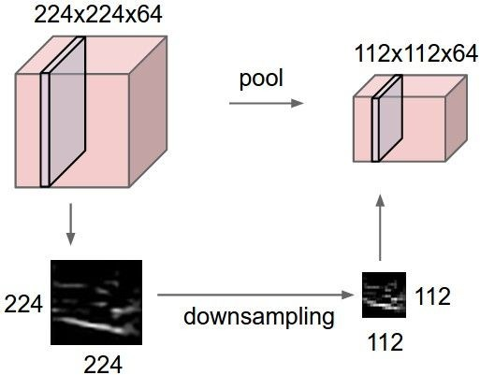
Pooling layer
makes the representations smaller and more manageable
operates over each activation map independently:

Slide 74
MAX POOLING
Single depth slice
1 | 1 | 2 | 4
5 | 6 | 7 | 8
3 | 2 | 1 | 0
1 | 2 | 3 | 4
x
max pool with 2x2 filters and stride 2
6 | 8
3 | 4
y

Slide 75
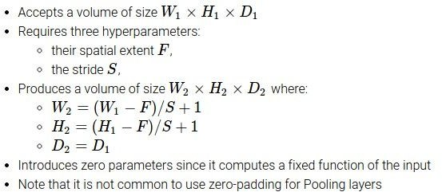

Slide 76
Common settings:
F = 2, S = 2
F = 3, S = 2

Slide 77
Fully Connected Layer (FC layer)
- Contains neurons that connect to the entire input volume, as in ordinary Neural Networks

Slide 78
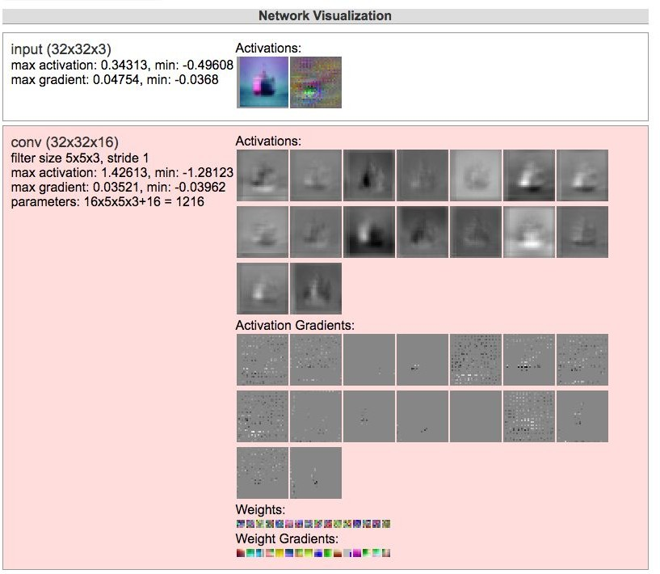
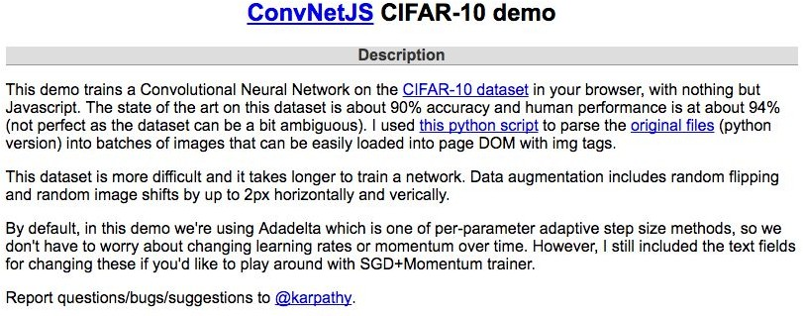
[ConvNetJS demo: training on CIFAR-10]
http://cs.stanford.edu/people/karpathy/convnetjs/demo/cifar10.html

Slide 79
Summary
ConvNets stack CONV,POOL,FC layers
Trend towards smaller filters and deeper architectures
Trend towards getting rid of POOL/FC layers (just CONV)
Typical architectures look like
[(CONV-RELU)*N-POOL?]*M-(FC-RELU)*K,SOFTMAX
where N is usually up to ~5, M is large, 0 <= K <= 2.
but recent advances such as ResNet/GoogLeNet challenge this paradigm

